Slide 1
Mobility Workforce Modeling
Update to the Data and Coordination Working Group
September 16, 2025

Slide 2
Moody’s economic modeling, Core Auto output and employment, 2018-2024, 2024-2030, 2030-2036

Slide 3
Moody’s economic modeling for the state of Michigan anticipates a 28.0% increase in output that is associated with a 1.1% increase in employment across Core Auto industries NAICS 3361-3362

Slide 4
Moody’s model for the United States anticipates a 35.7% increase in output associated with a 7.1% increase in employment across Core Auto industries NAICS 3361-3362

Slide 5
U.S. and Michigan Automotive Sales and Production, Historical Trends

Slide 6
Domestic vehicle production has declined significantly since 2015. U.S. vehicle sales have fluctuated but remain near levels seen prior to the pandemic.

Slide 7
Michigan employment in Core Automotive has remained relatively consistent in recent years despite declining domestic vehicle production

Slide 8
Michigan Gross Domestic Product in Vehicle Manufacturing

Slide 9
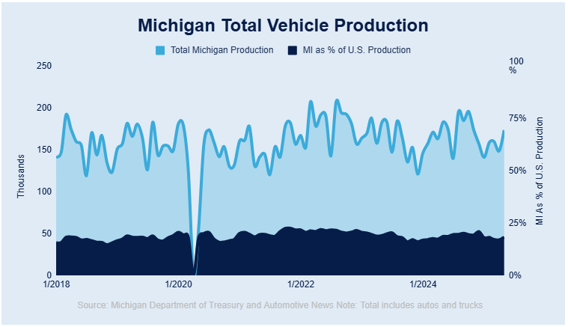
MichAuto Data Interactive shows fluctuation around 150,000 cars and trucks produced each month in Michigan since 2018. Michigan’s share of U.S. vehicle production stands at 18.4% as of Feb-2025.

Slide 10
CAR Automotive Sales and Production Forecasts

Slide 11
Sales forecasts by the Center for Automotive Research model the scenario where BEV and Hybrid vehicle sales exceed 50% of the market by 2030

Slide 12
Michigan vehicle production increases 27.5%, from 1.7 to 2.2 million units per year by 2030

Slide 13
Expansion of electric motor production drives overall engine production in Michigan through 2030

Slide 14
Shares of Electric and Dedicated Hybrid transmission production are projected to increase, as overall transmission production modestly declines in Michigan through 2030

Slide 15
Mobility shares of Michigan Payroll Employment

Slide 16
Broadly defined, Mobility industry employment represents 23.9% of employment in Jan-2000, 18.2% of employment in Dec-2024

Slide 17
OEM employment (Core Auto + Engineering), 11.2% of employment in Jan-2000, 7.6% of employment in Dec-2024

Slide 18
MCDA Data Exploration

Slide 19
Major Occupation Groups, Shares of industry employment across the supply chain

Slide 20
Major Occupation Groups, Shares of industry employment across the supply chain

Slide 21
Core Automotive employment is dominated by production occupations with median annual salaries of around $47k

Slide 22
Detailed Production Occupations within Core Automotive

Slide 23
Detailed Architecture and Engineering Occupations within Core Automotive

Slide 24
Detailed Management Occupations within Core Automotive

Slide 25
Occupational Employment Change by Education, Observed (2021-2024) and Projected (2024-2034)

Slide 26
Within Core Auto (NAICS 3361-3363), most of the recent-year’s employment growth has occurred among occupations typically requiring a Bachelor’s degree or greater

Slide 27
BA+ occupations have also seen an outsized share of growth across the more broadly defined mobility supply chain

Slide 28
The previous slides’ results align with expectations from the BLS Occupational Projections (2024-34), with employment growth centered on higher-skilled occupations. Annual openings remain high among occupations with lower educational requirements due to churn.

Slide 29
Next Steps

Slide 30
Next Steps
Prorating Michigan Mobility Employment (Total Supply Chain) to estimate Auto-related employment shares of connected industries
Meeting with Bureau of Economic Analysis
Suggested Make-Use Tables (National), deducting import shares of commodities by industry
Regional Impact Modeling (RIMS II), as an alternative
Similar exploration with a Lightcast Make-use table
Action: Follow up with CAR to discuss methodology
Deeper dive into occupations across the mobility supply chain
Linking to U.S. / Michigan Occupational Employment Projections
Assessing Job Openings, Skills, by Occupation
Developing the near-term forecast model to incorporate CAR’s production forecasts

Slide 31
EV Transition Figures
Automatically generated from reports/figures

Slide 32
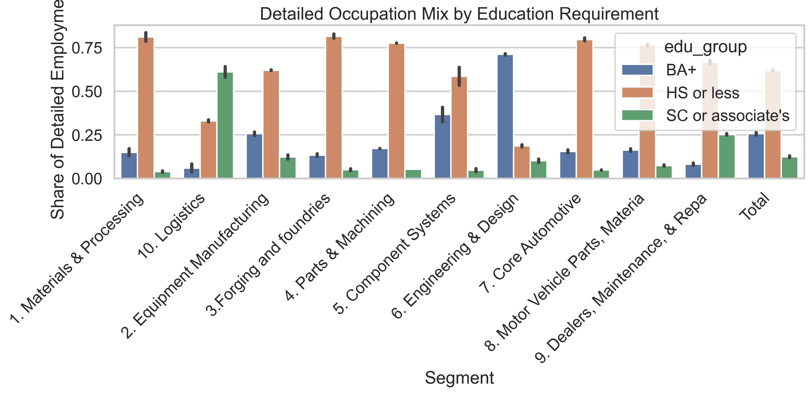
Mcda Detailed Education Mix
Source: EV Transition Forecasts

Slide 33
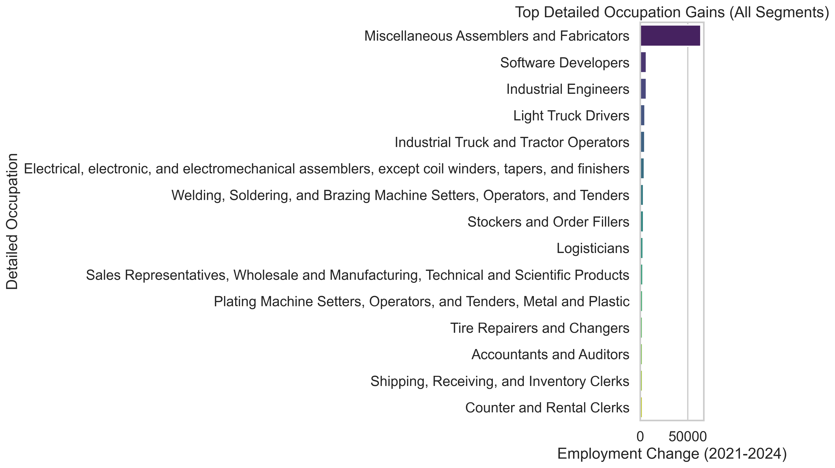
Mcda Detailed Top Changes
Source: EV Transition Forecasts

Slide 34
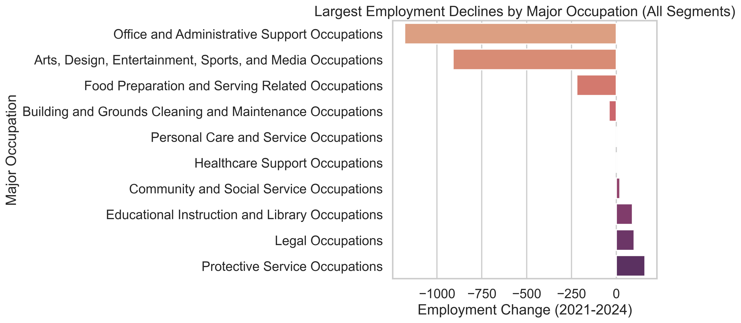
Mcda Major Bottom Changes
Source: EV Transition Forecasts

Slide 35
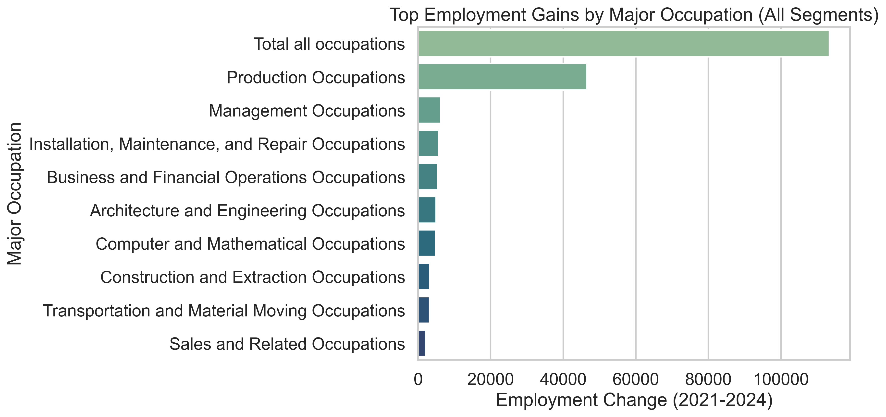
Mcda Major Top Changes
Source: EV Transition Forecasts

Slide 36
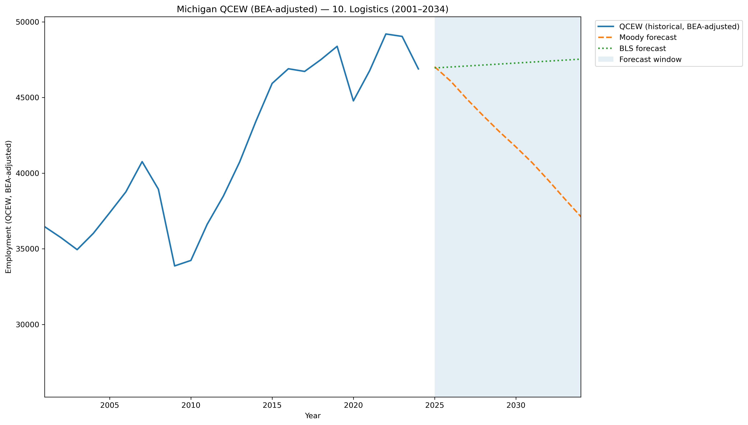
Mi Qcew Bea Segment 10 Compare 2001 2034
Source: EV Transition Forecasts

Slide 37
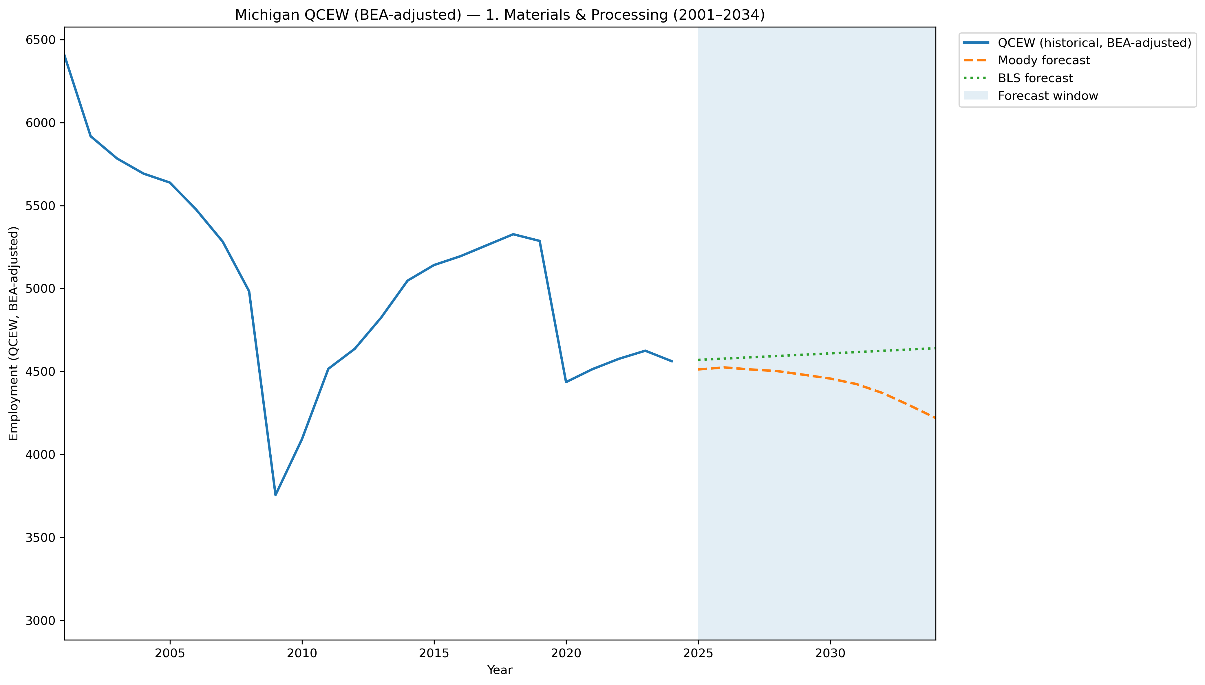
Mi Qcew Bea Segment 1 Compare 2001 2034
Source: EV Transition Forecasts

Slide 38
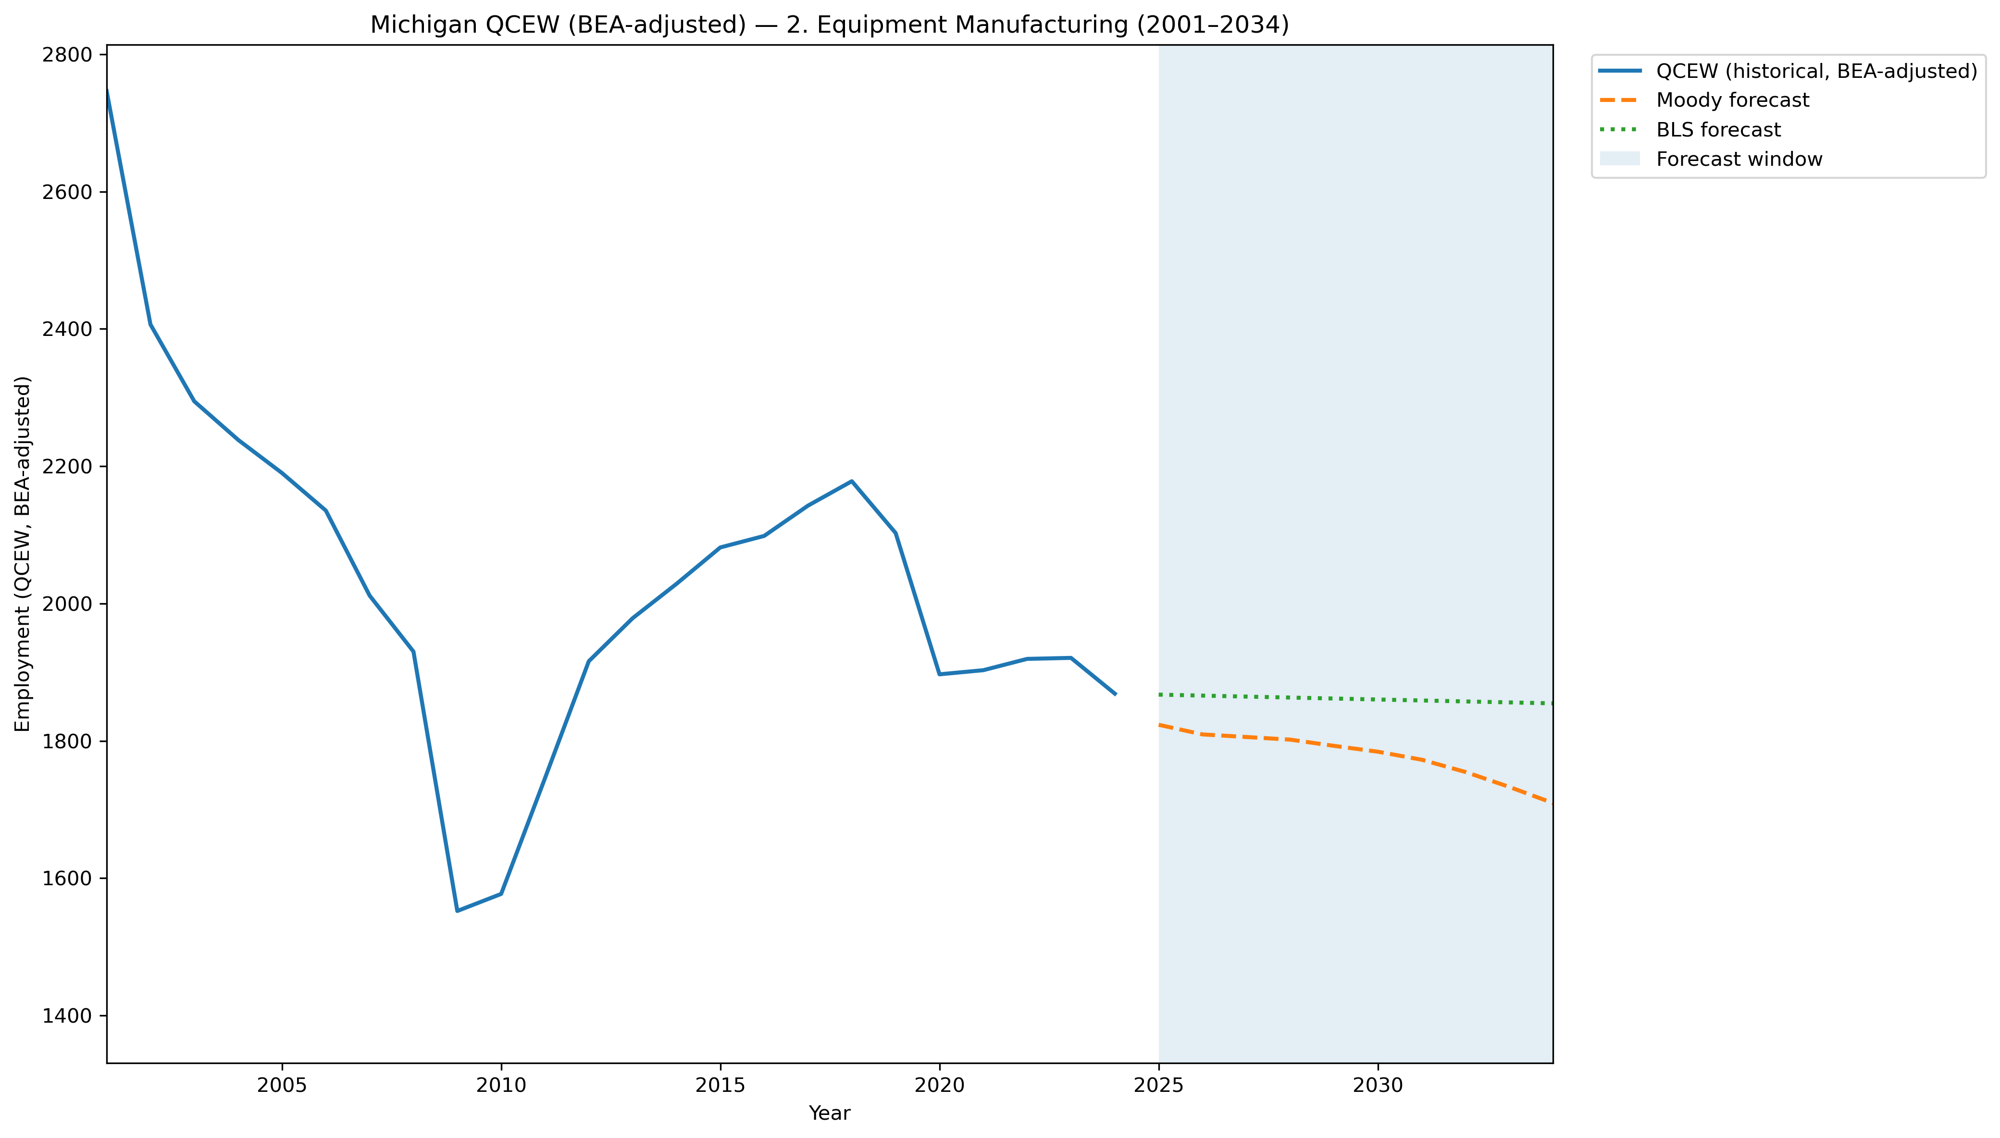
Mi Qcew Bea Segment 2 Compare 2001 2034
Source: EV Transition Forecasts

Slide 39
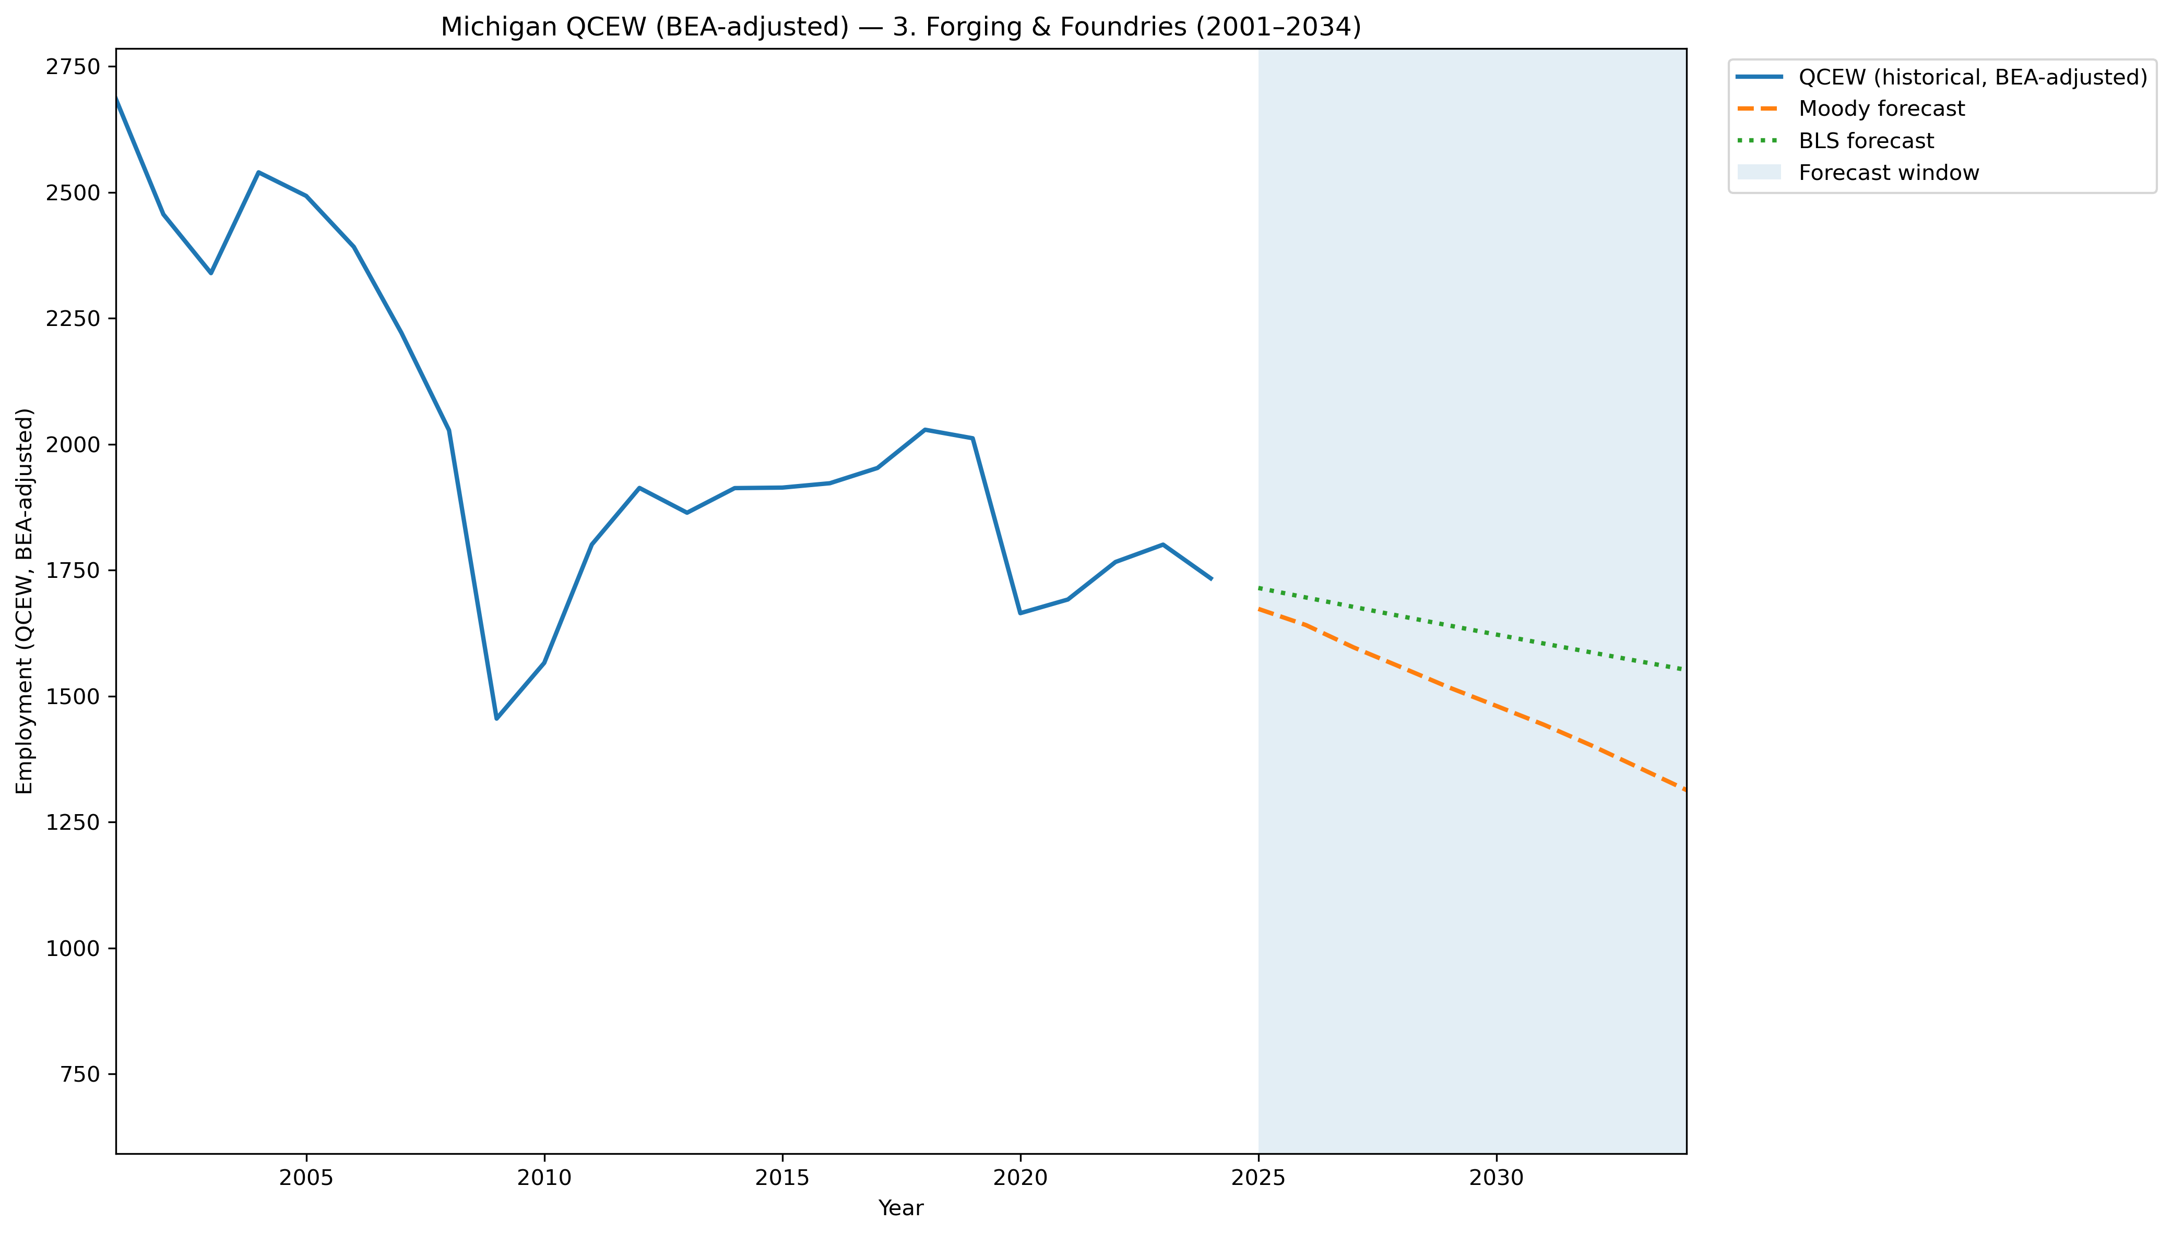
Mi Qcew Bea Segment 3 Compare 2001 2034
Source: EV Transition Forecasts

Slide 40
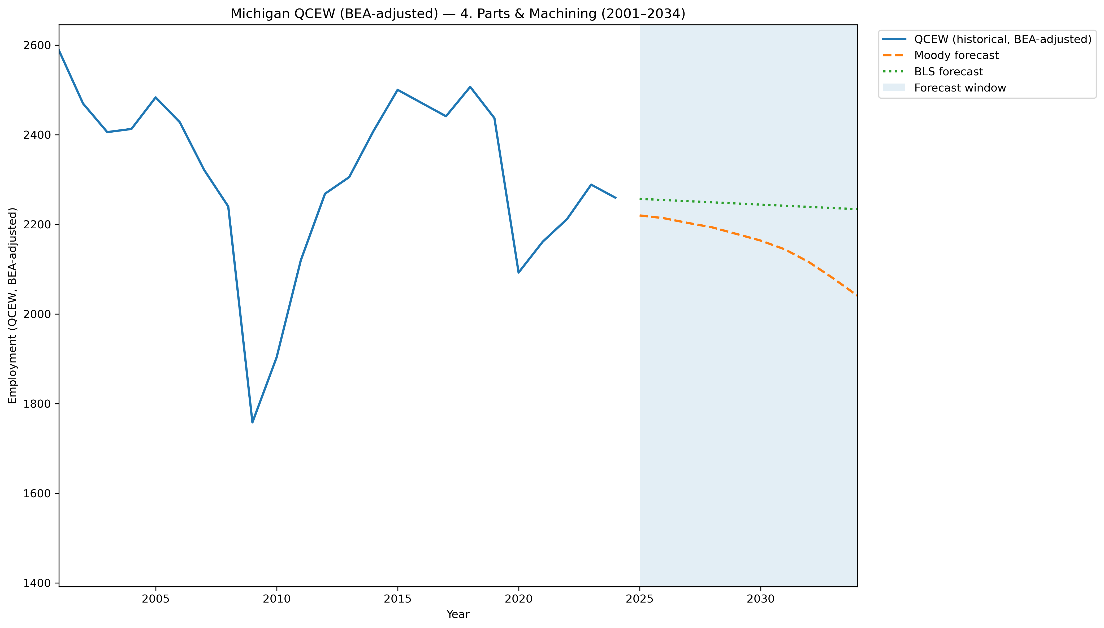
Mi Qcew Bea Segment 4 Compare 2001 2034
Source: EV Transition Forecasts

Slide 41
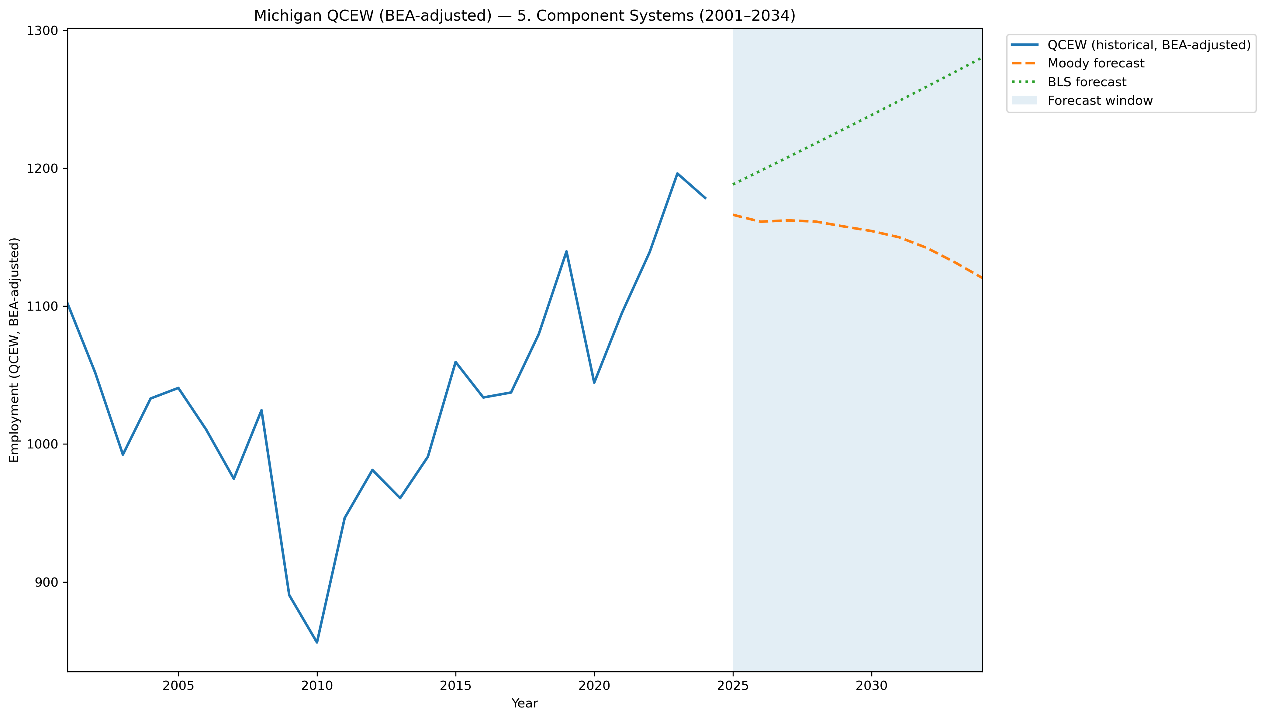
Mi Qcew Bea Segment 5 Compare 2001 2034
Source: EV Transition Forecasts

Slide 42
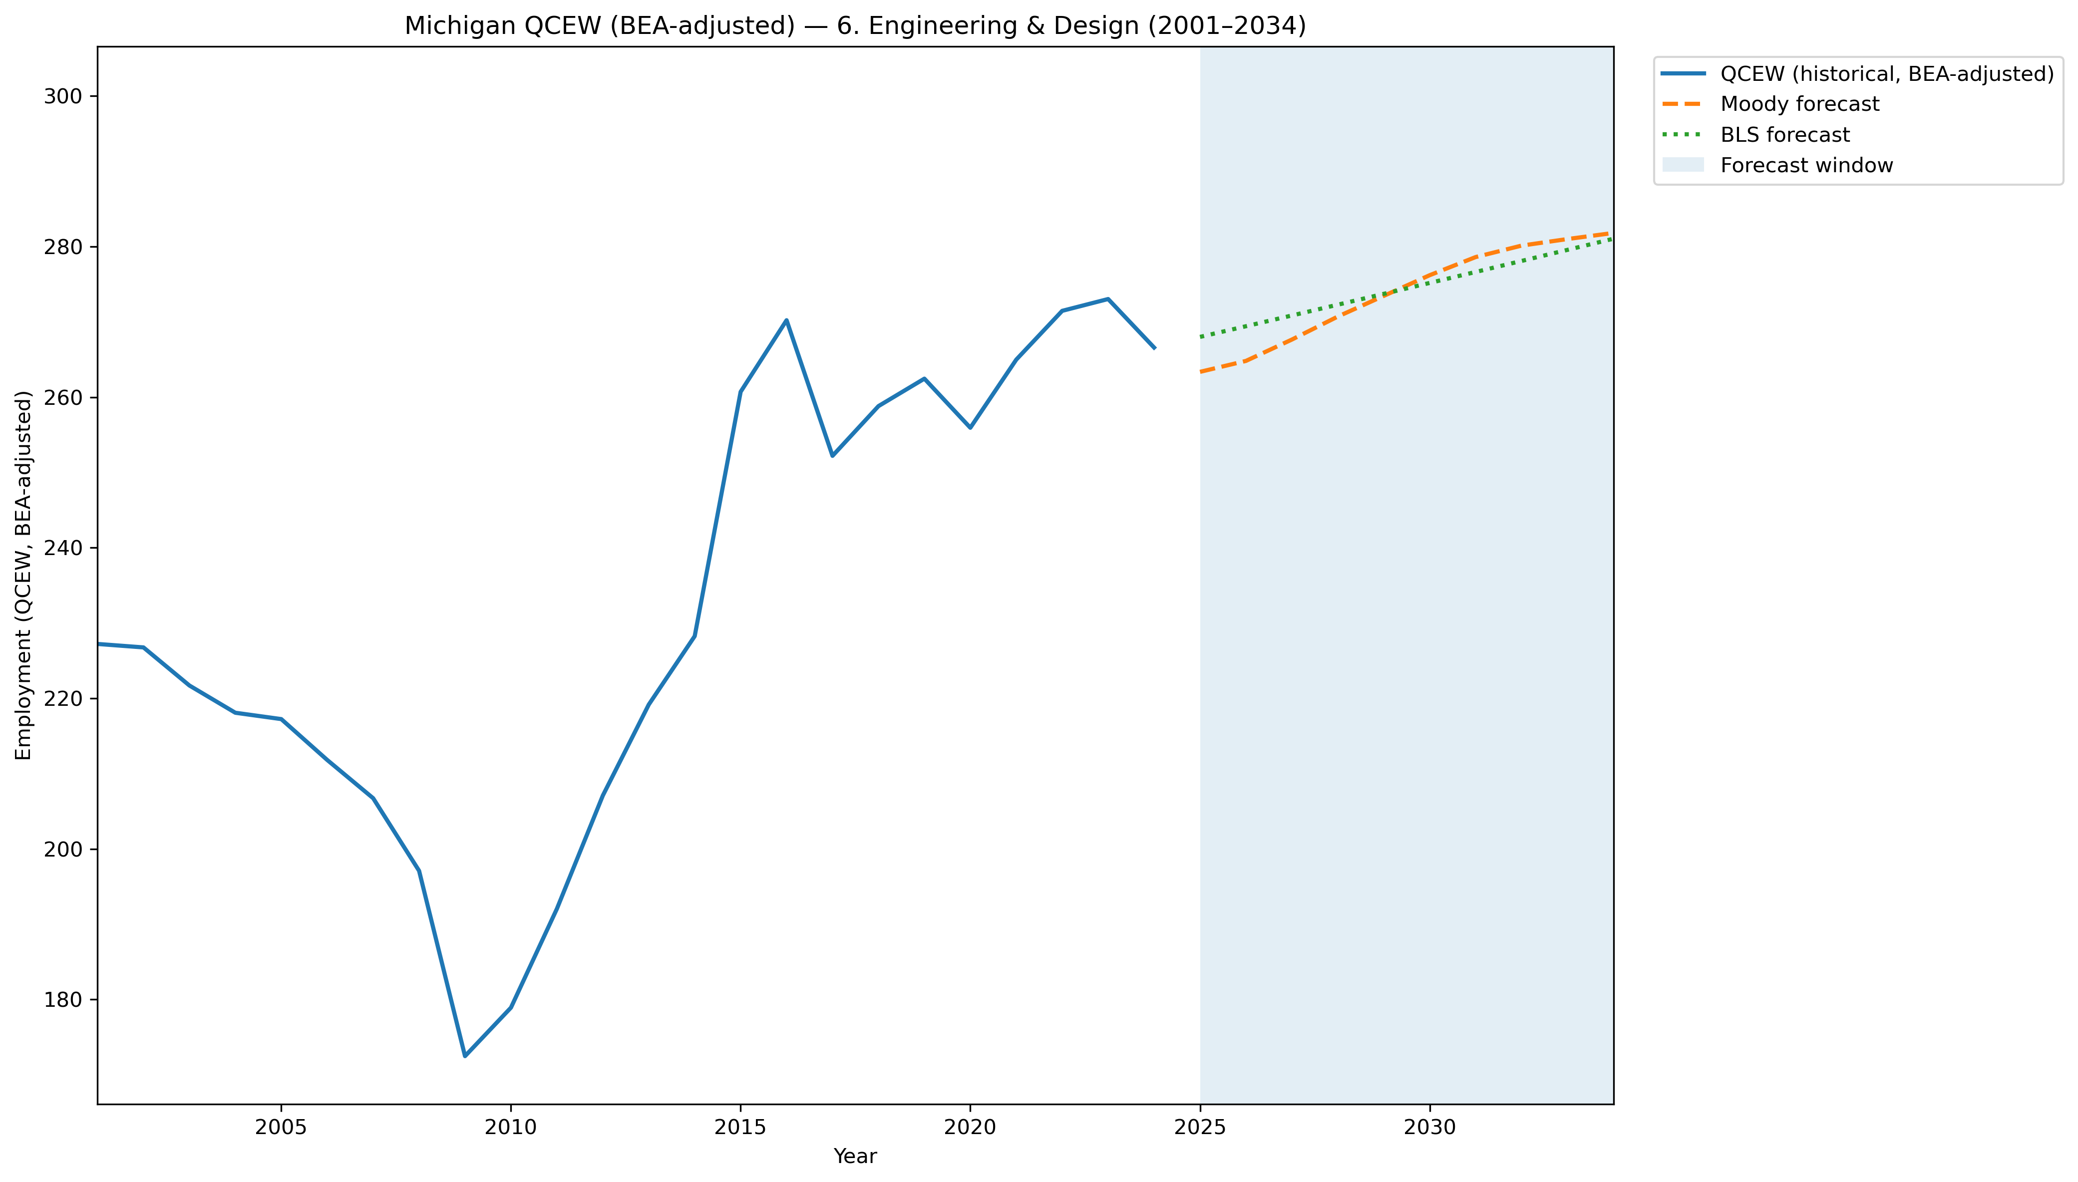
Mi Qcew Bea Segment 6 Compare 2001 2034
Source: EV Transition Forecasts

Slide 43
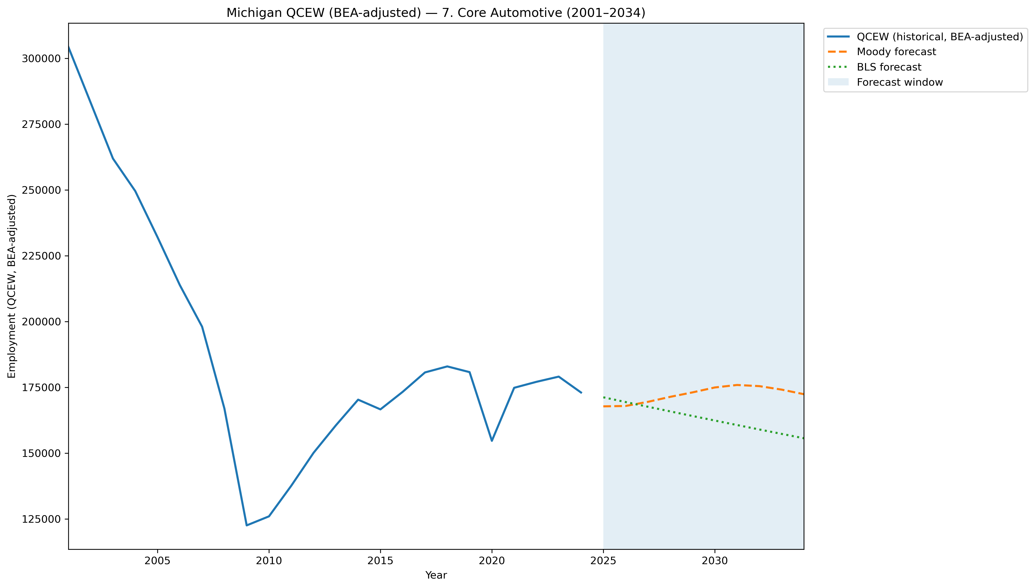
Mi Qcew Bea Segment 7 Compare 2001 2034
Source: EV Transition Forecasts

Slide 44
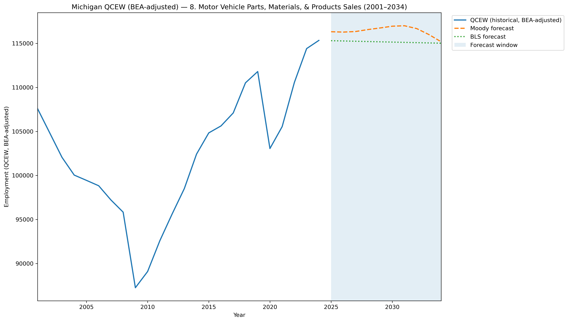
Mi Qcew Bea Segment 8 Compare 2001 2034
Source: EV Transition Forecasts

Slide 45
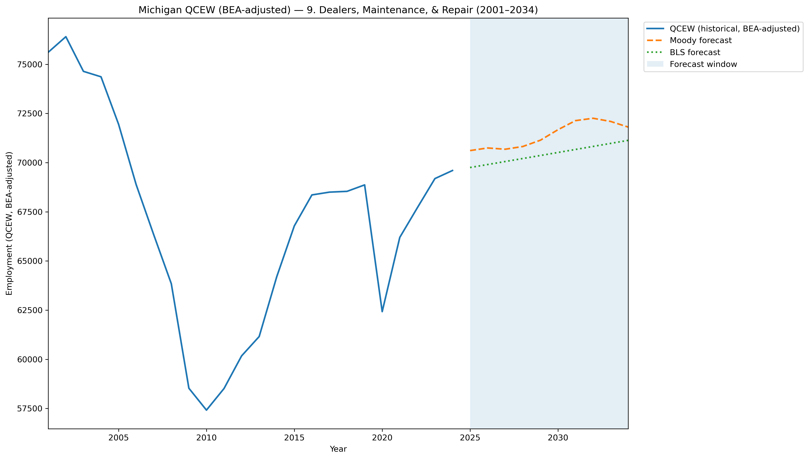
Mi Qcew Bea Segment 9 Compare 2001 2034
Source: EV Transition Forecasts

Slide 46
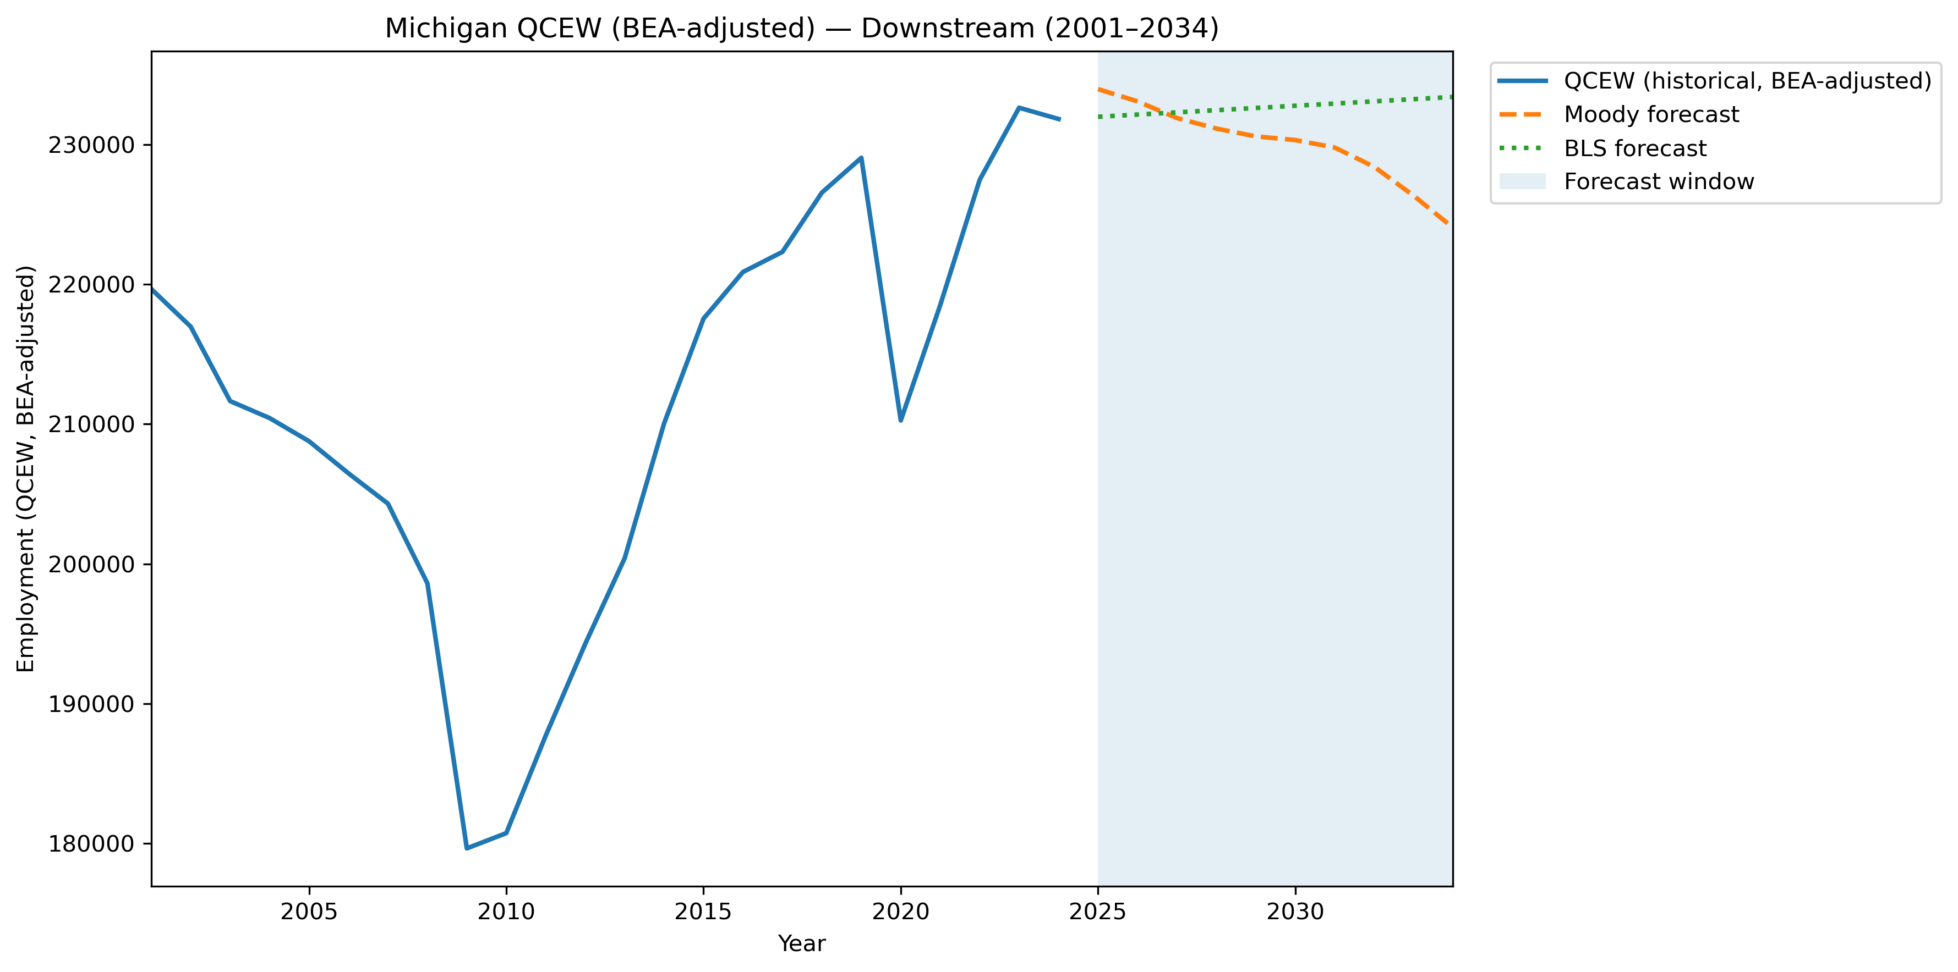
Mi Qcew Bea Stage Downstream Compare 2001 2034
Source: EV Transition Forecasts

Slide 47
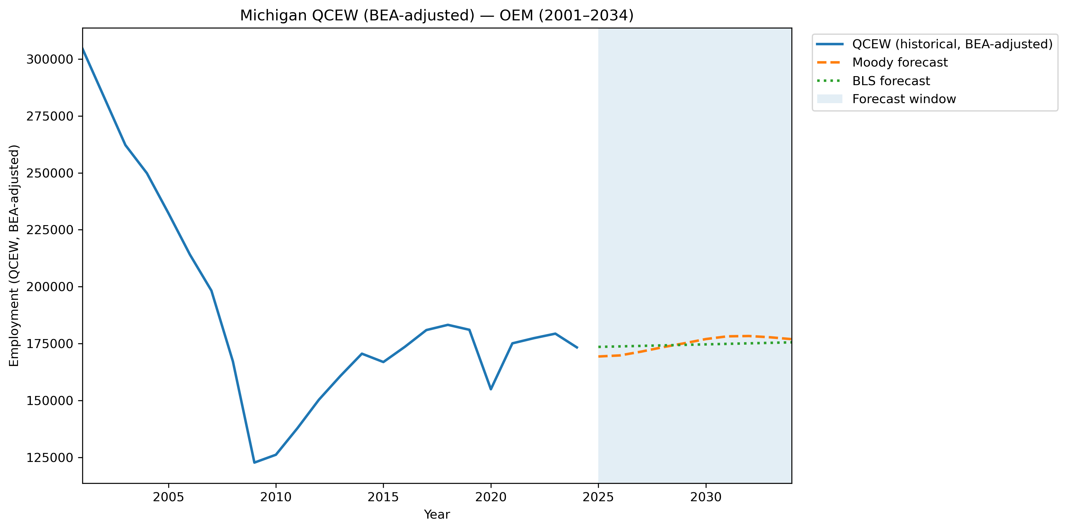
Mi Qcew Bea Stage Oem Compare 2001 2034
Source: EV Transition Forecasts

Slide 48
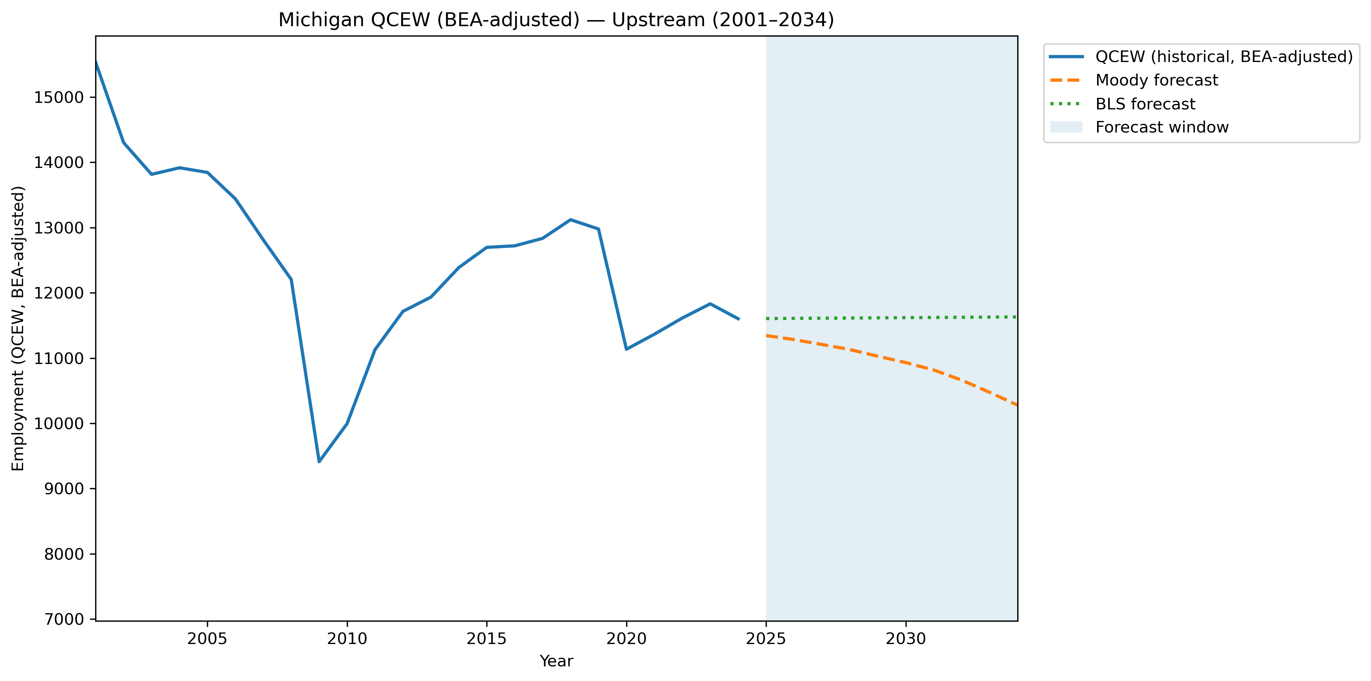
Mi Qcew Bea Stage Upstream Compare 2001 2034
Source: EV Transition Forecasts

Slide 49
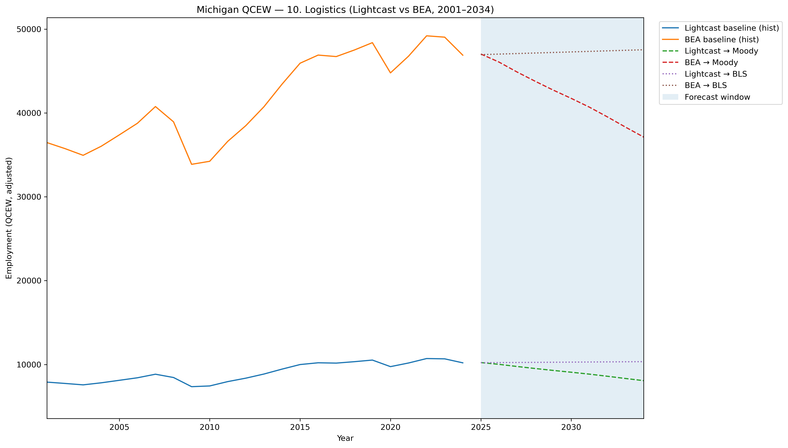
Mi Qcew Compare Segment 10 Lightcast Vs Bea 2001 2034
Source: EV Transition Forecasts

Slide 50
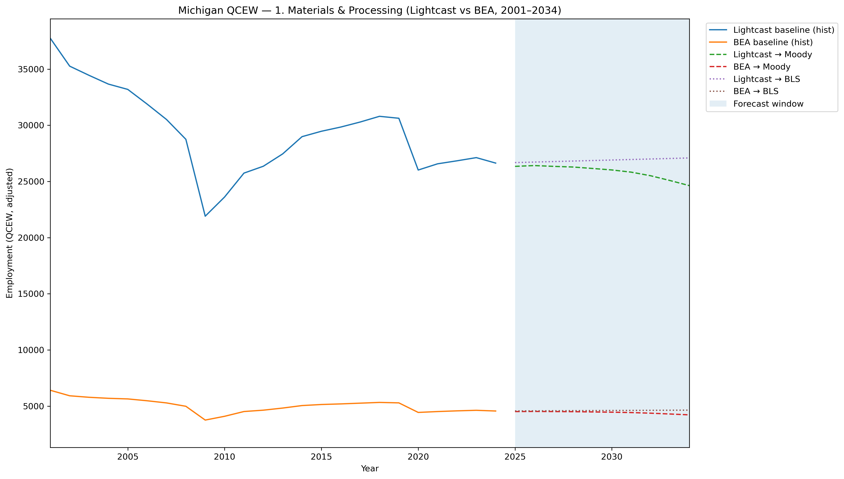
Mi Qcew Compare Segment 1 Lightcast Vs Bea 2001 2034
Source: EV Transition Forecasts

Slide 51
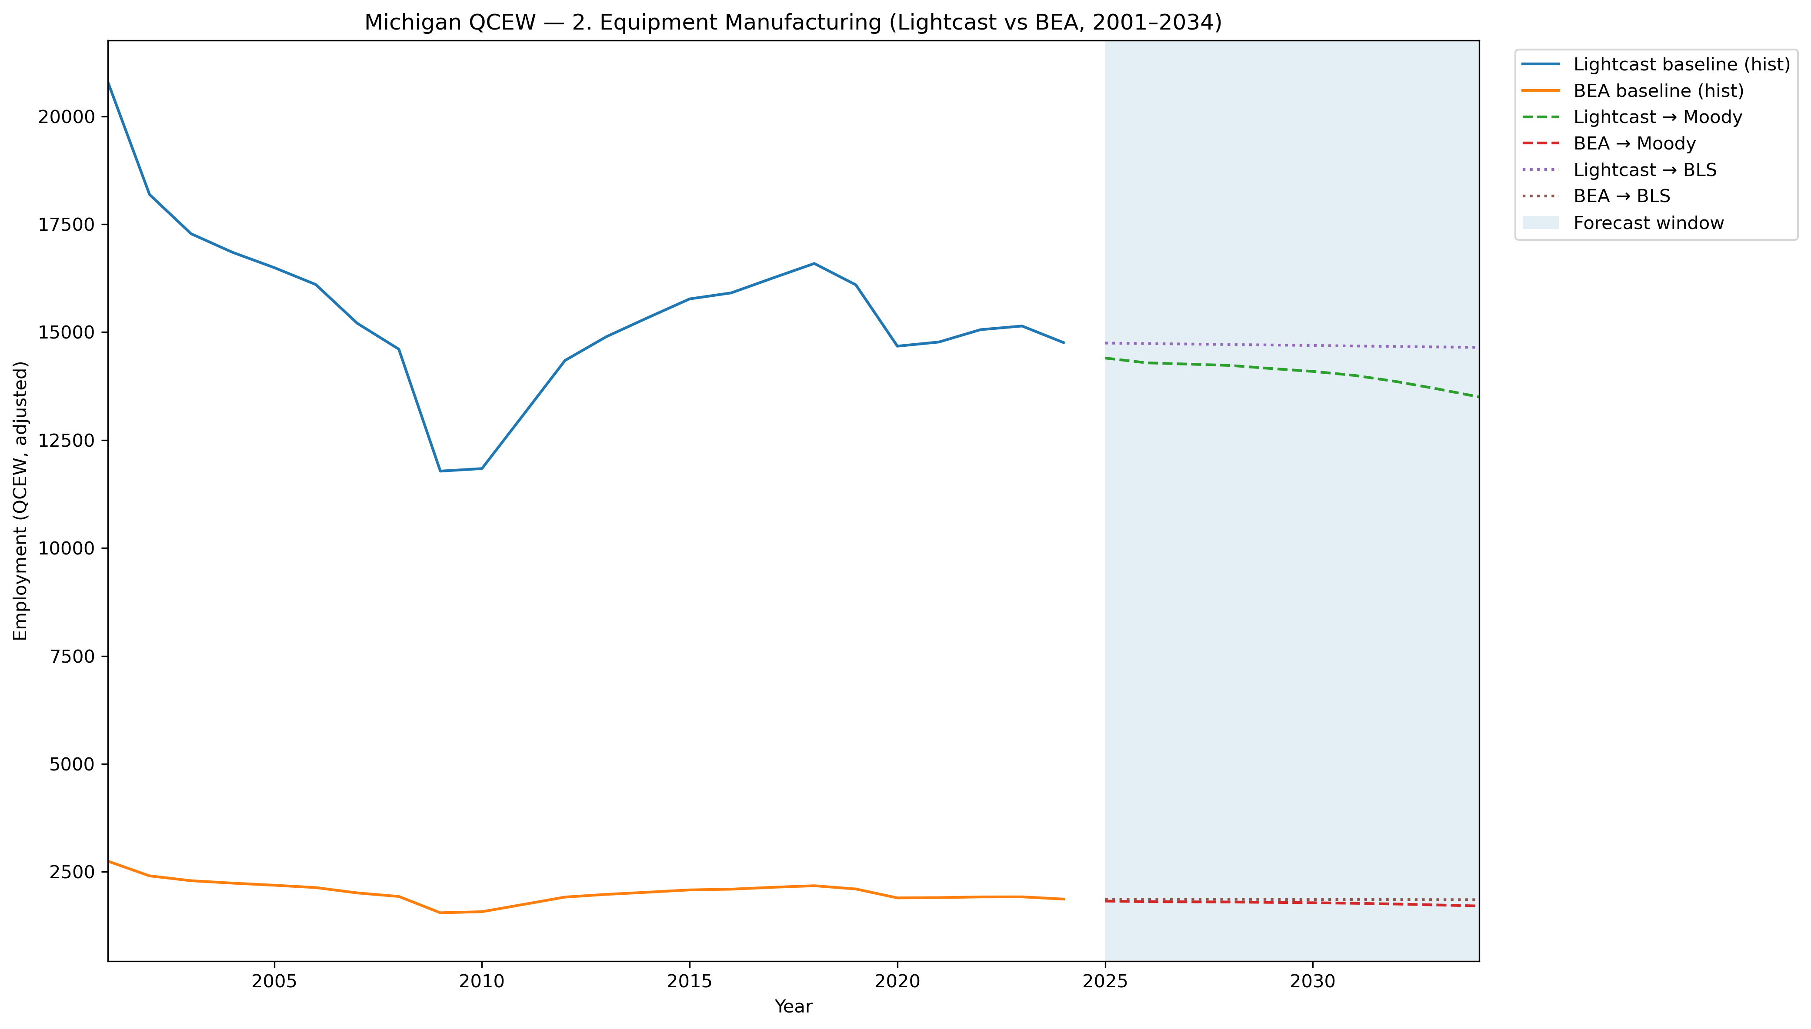
Mi Qcew Compare Segment 2 Lightcast Vs Bea 2001 2034
Source: EV Transition Forecasts

Slide 52
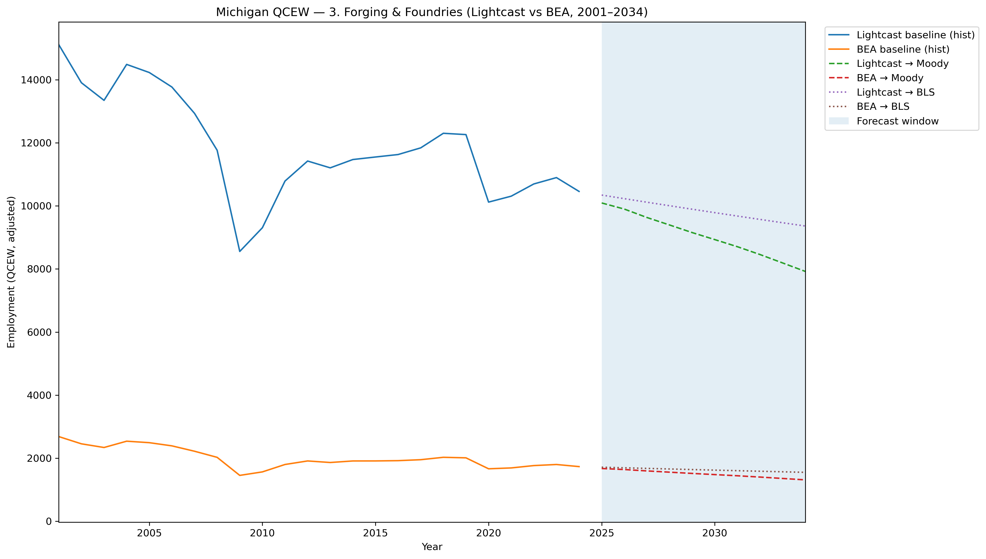
Mi Qcew Compare Segment 3 Lightcast Vs Bea 2001 2034
Source: EV Transition Forecasts

Slide 53
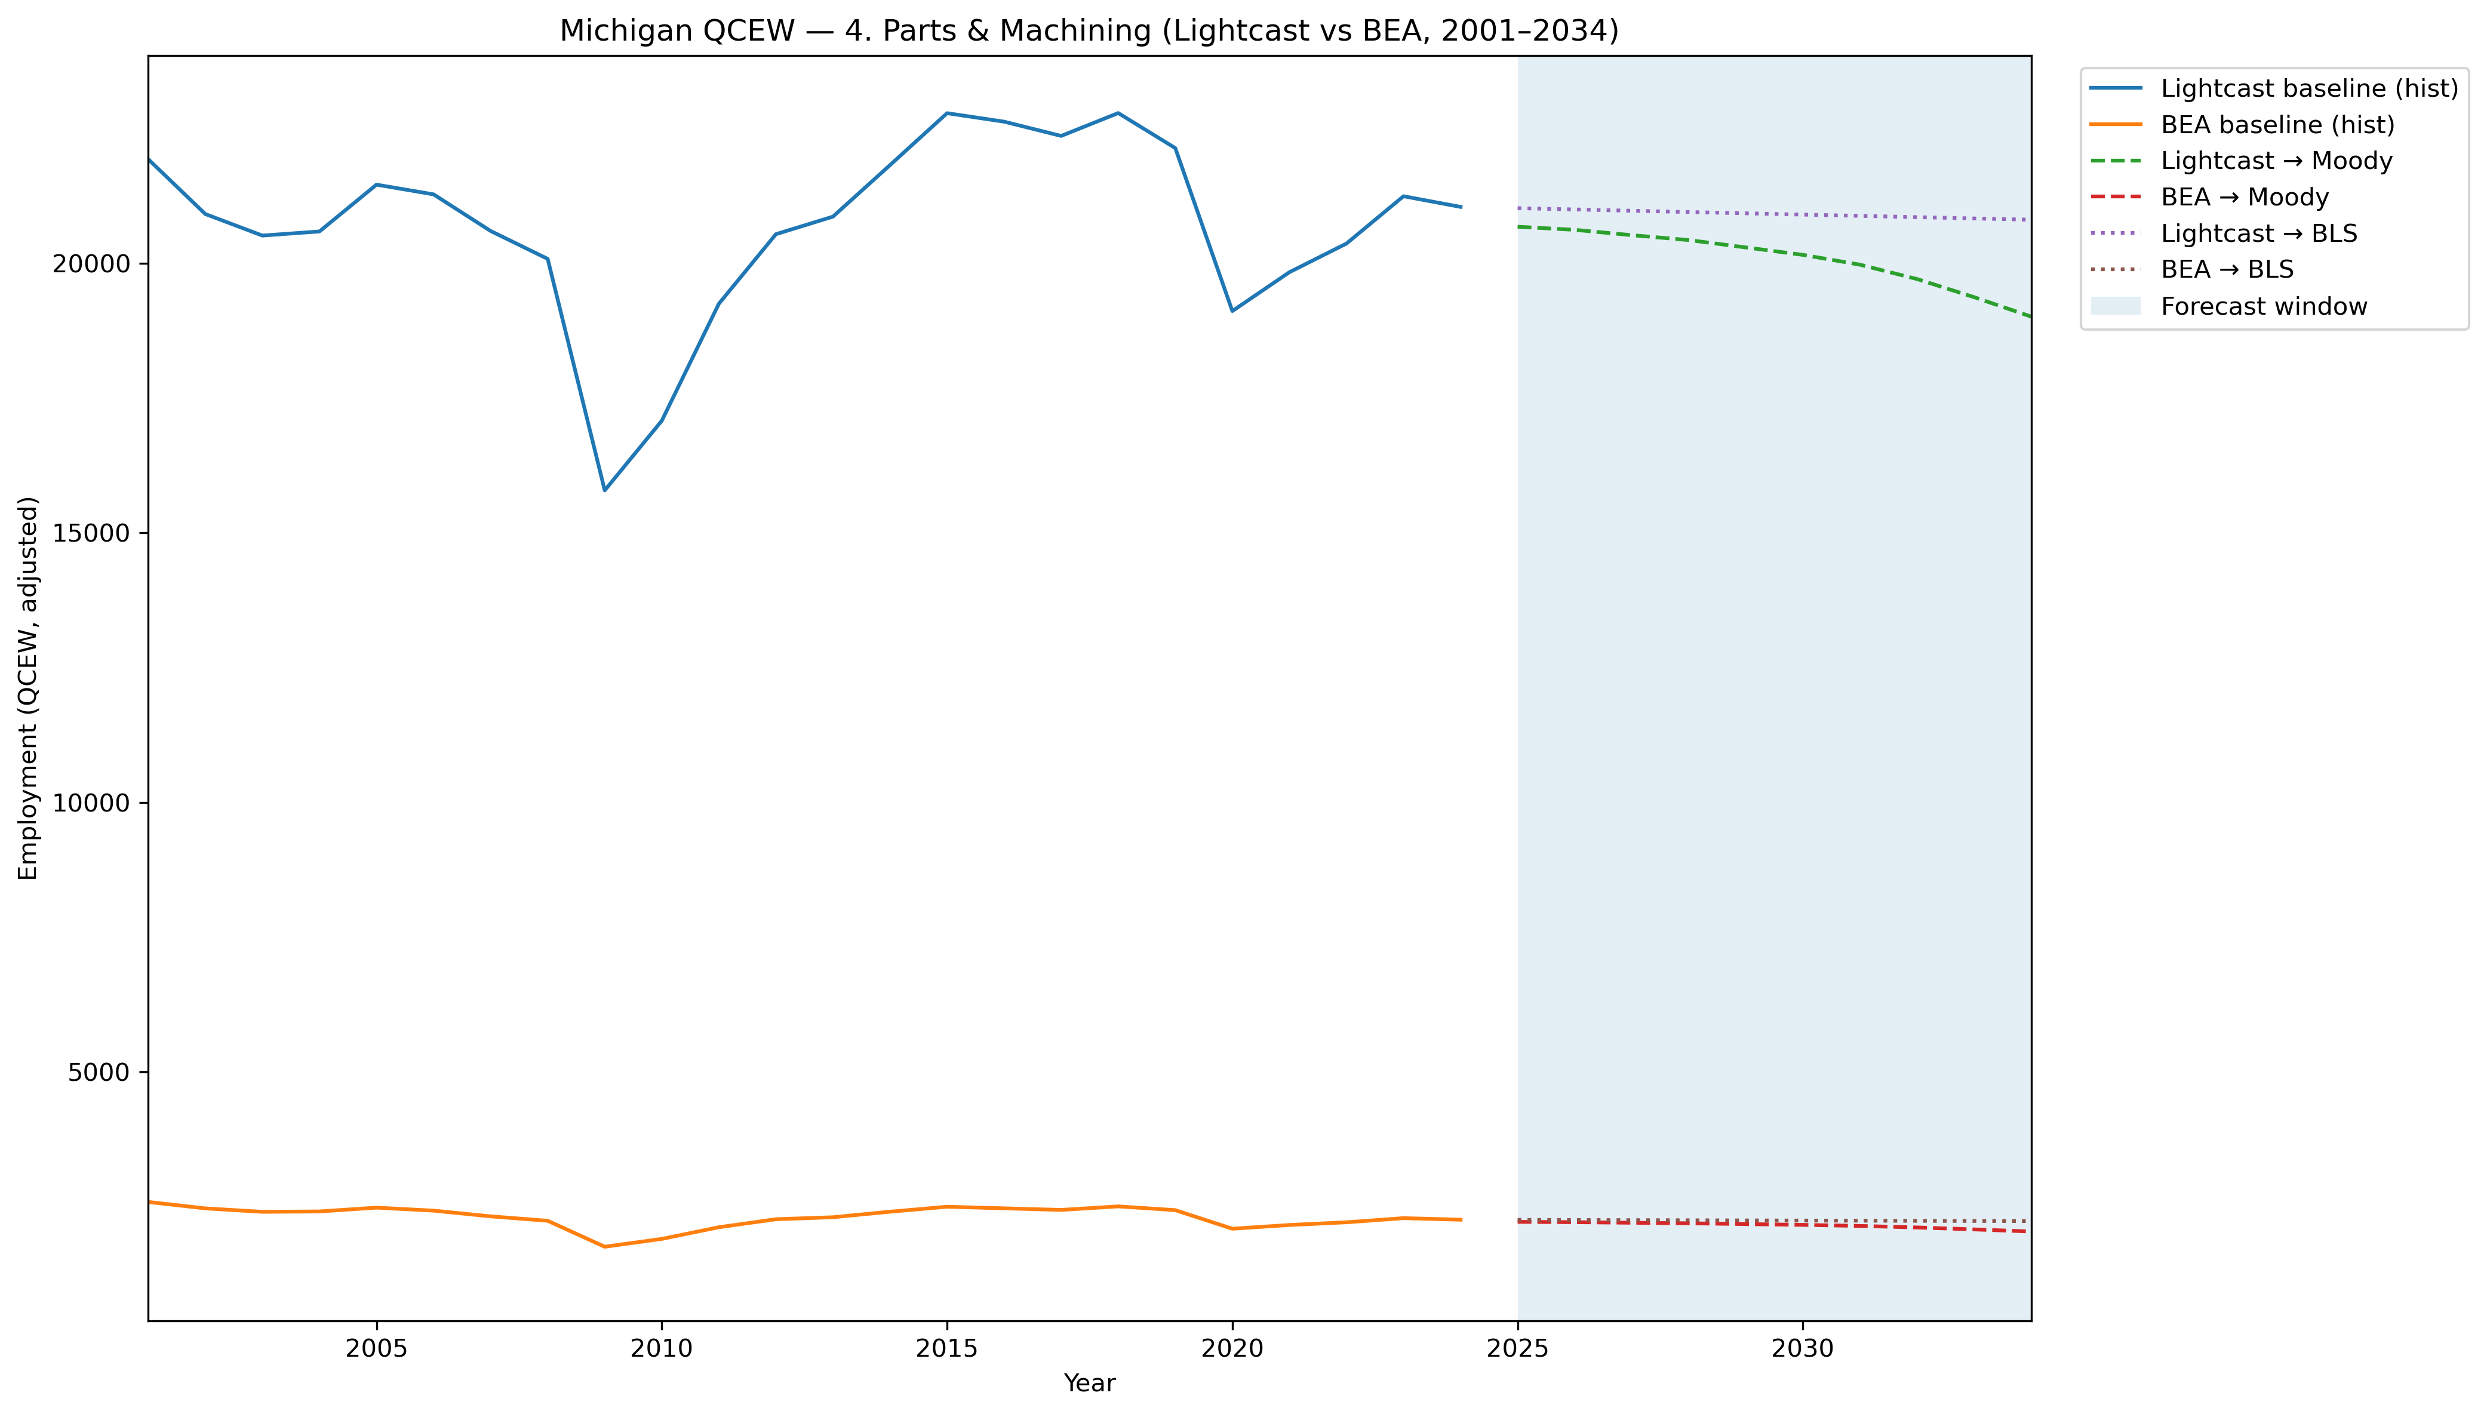
Mi Qcew Compare Segment 4 Lightcast Vs Bea 2001 2034
Source: EV Transition Forecasts

Slide 54
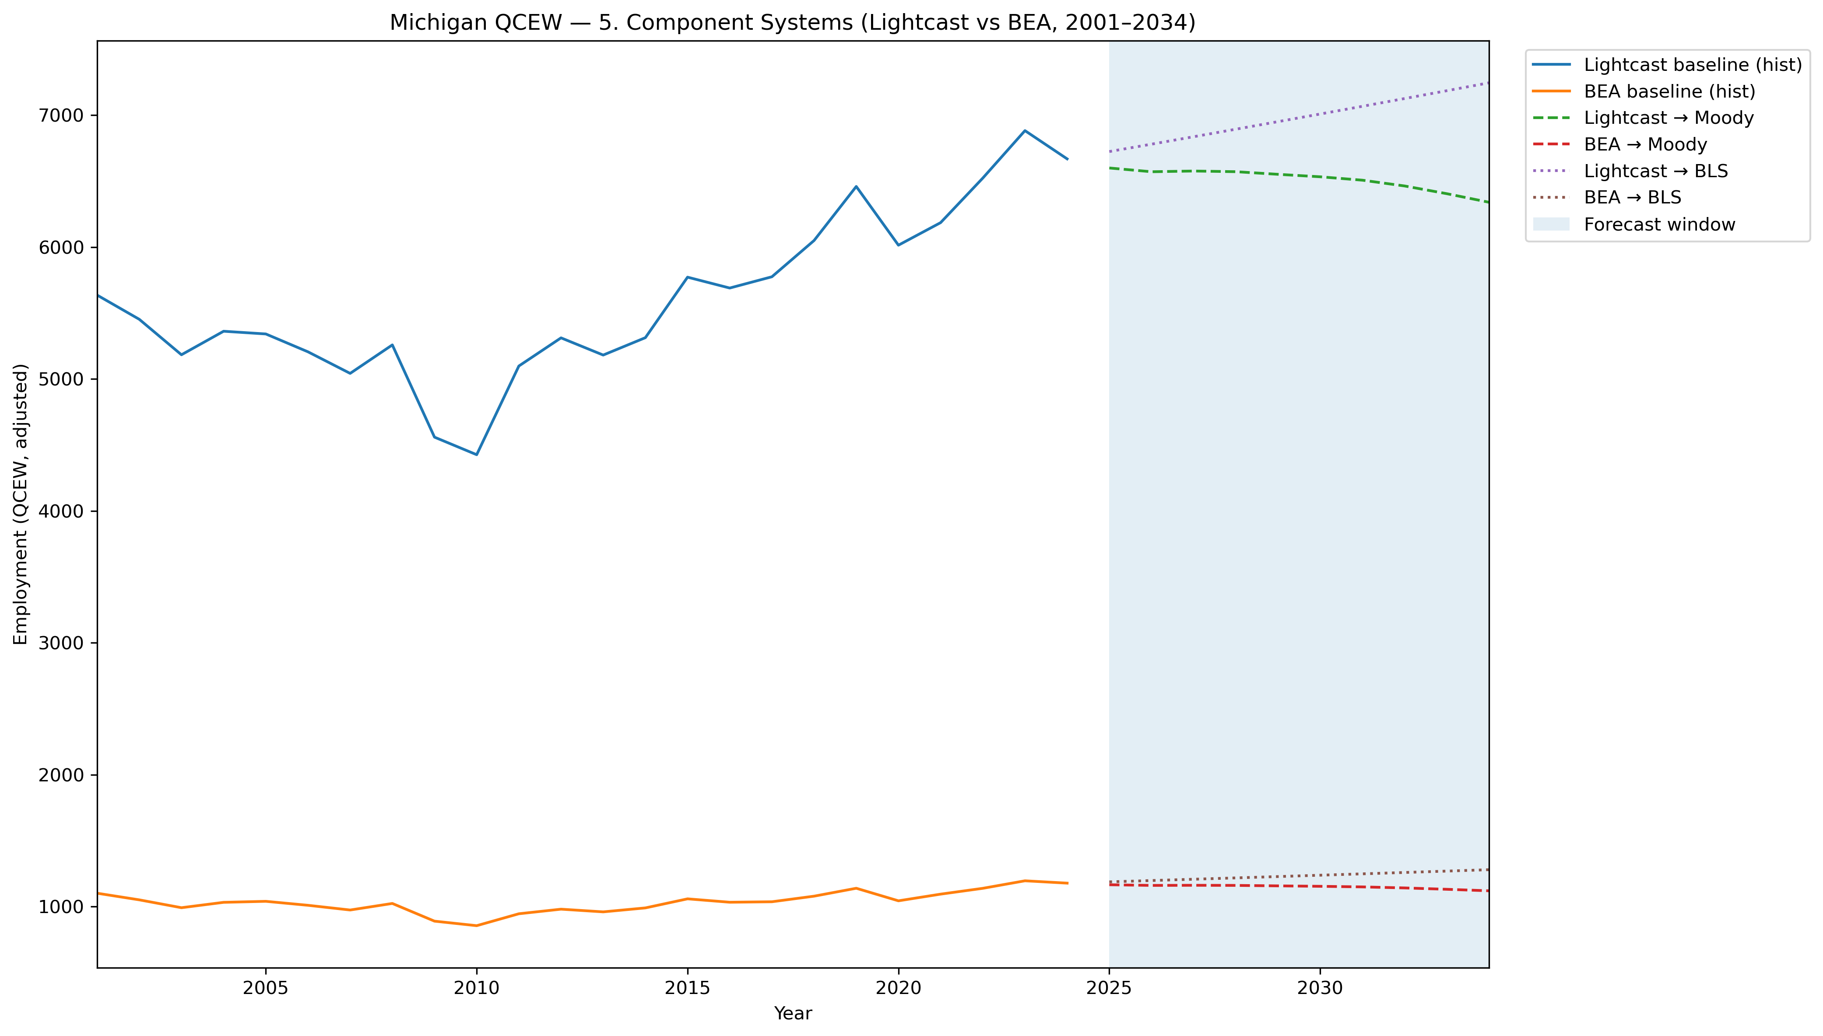
Mi Qcew Compare Segment 5 Lightcast Vs Bea 2001 2034
Source: EV Transition Forecasts

Slide 55
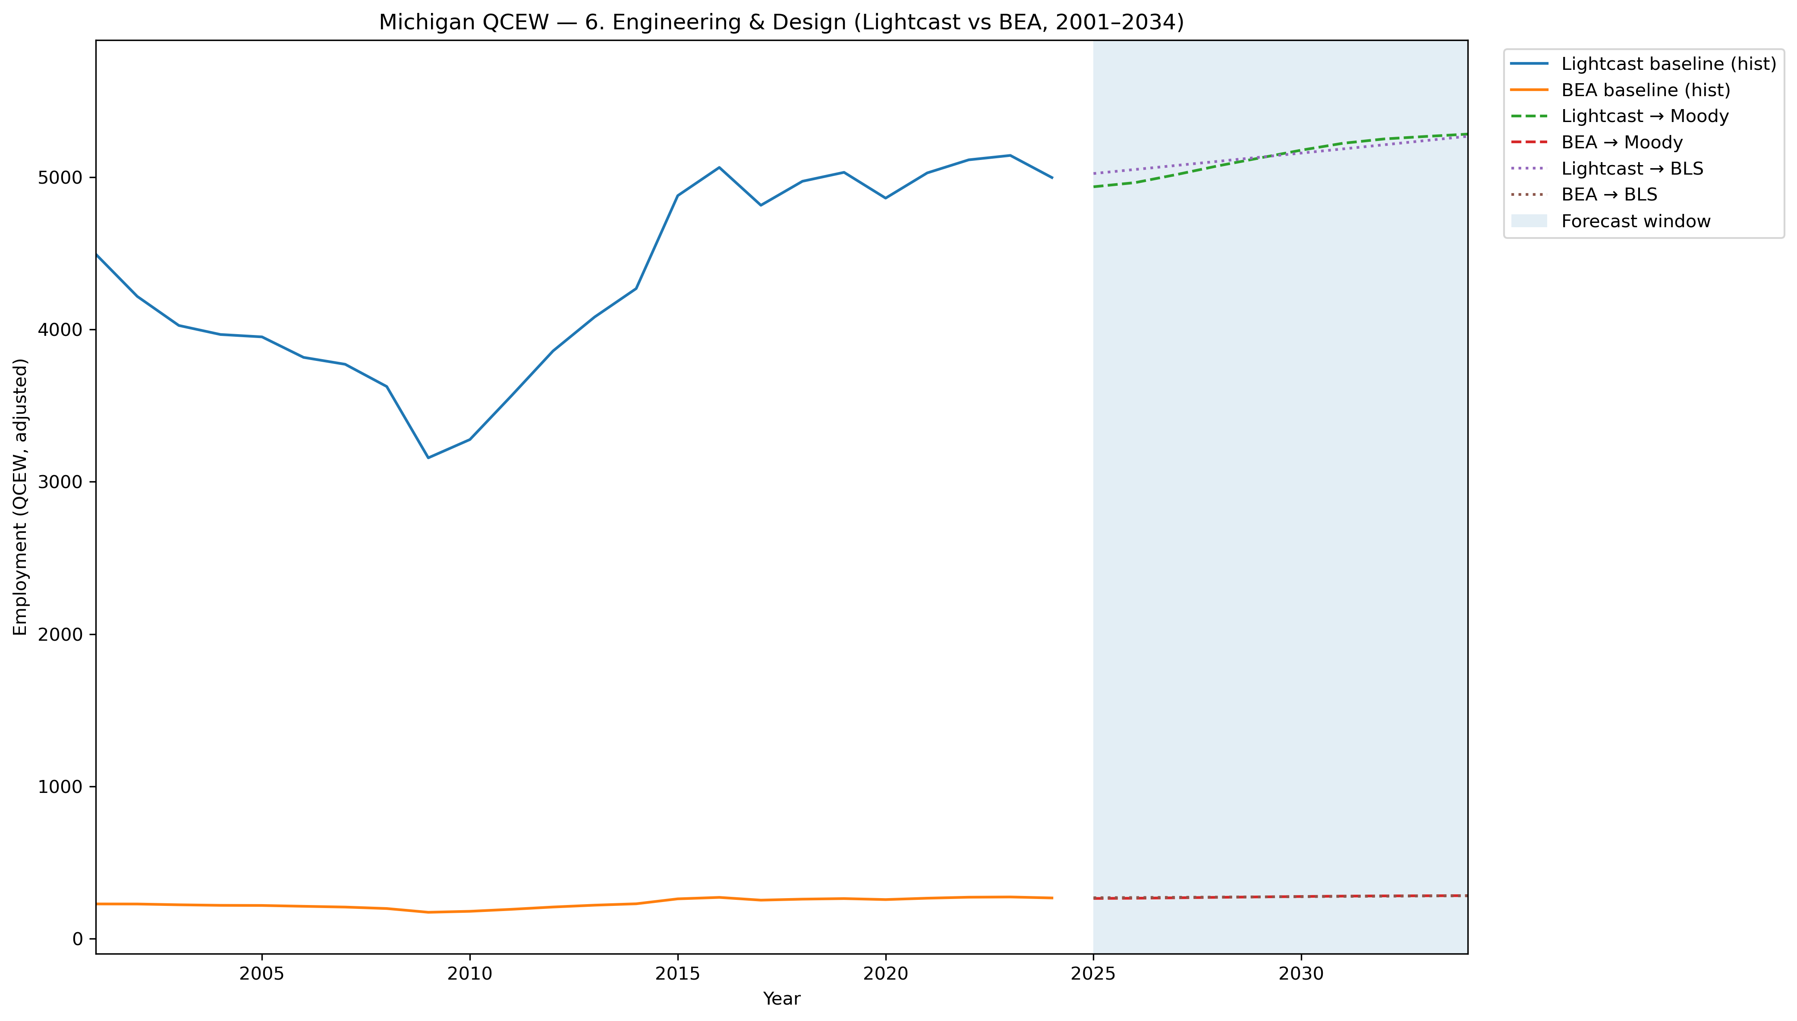
Mi Qcew Compare Segment 6 Lightcast Vs Bea 2001 2034
Source: EV Transition Forecasts

Slide 56
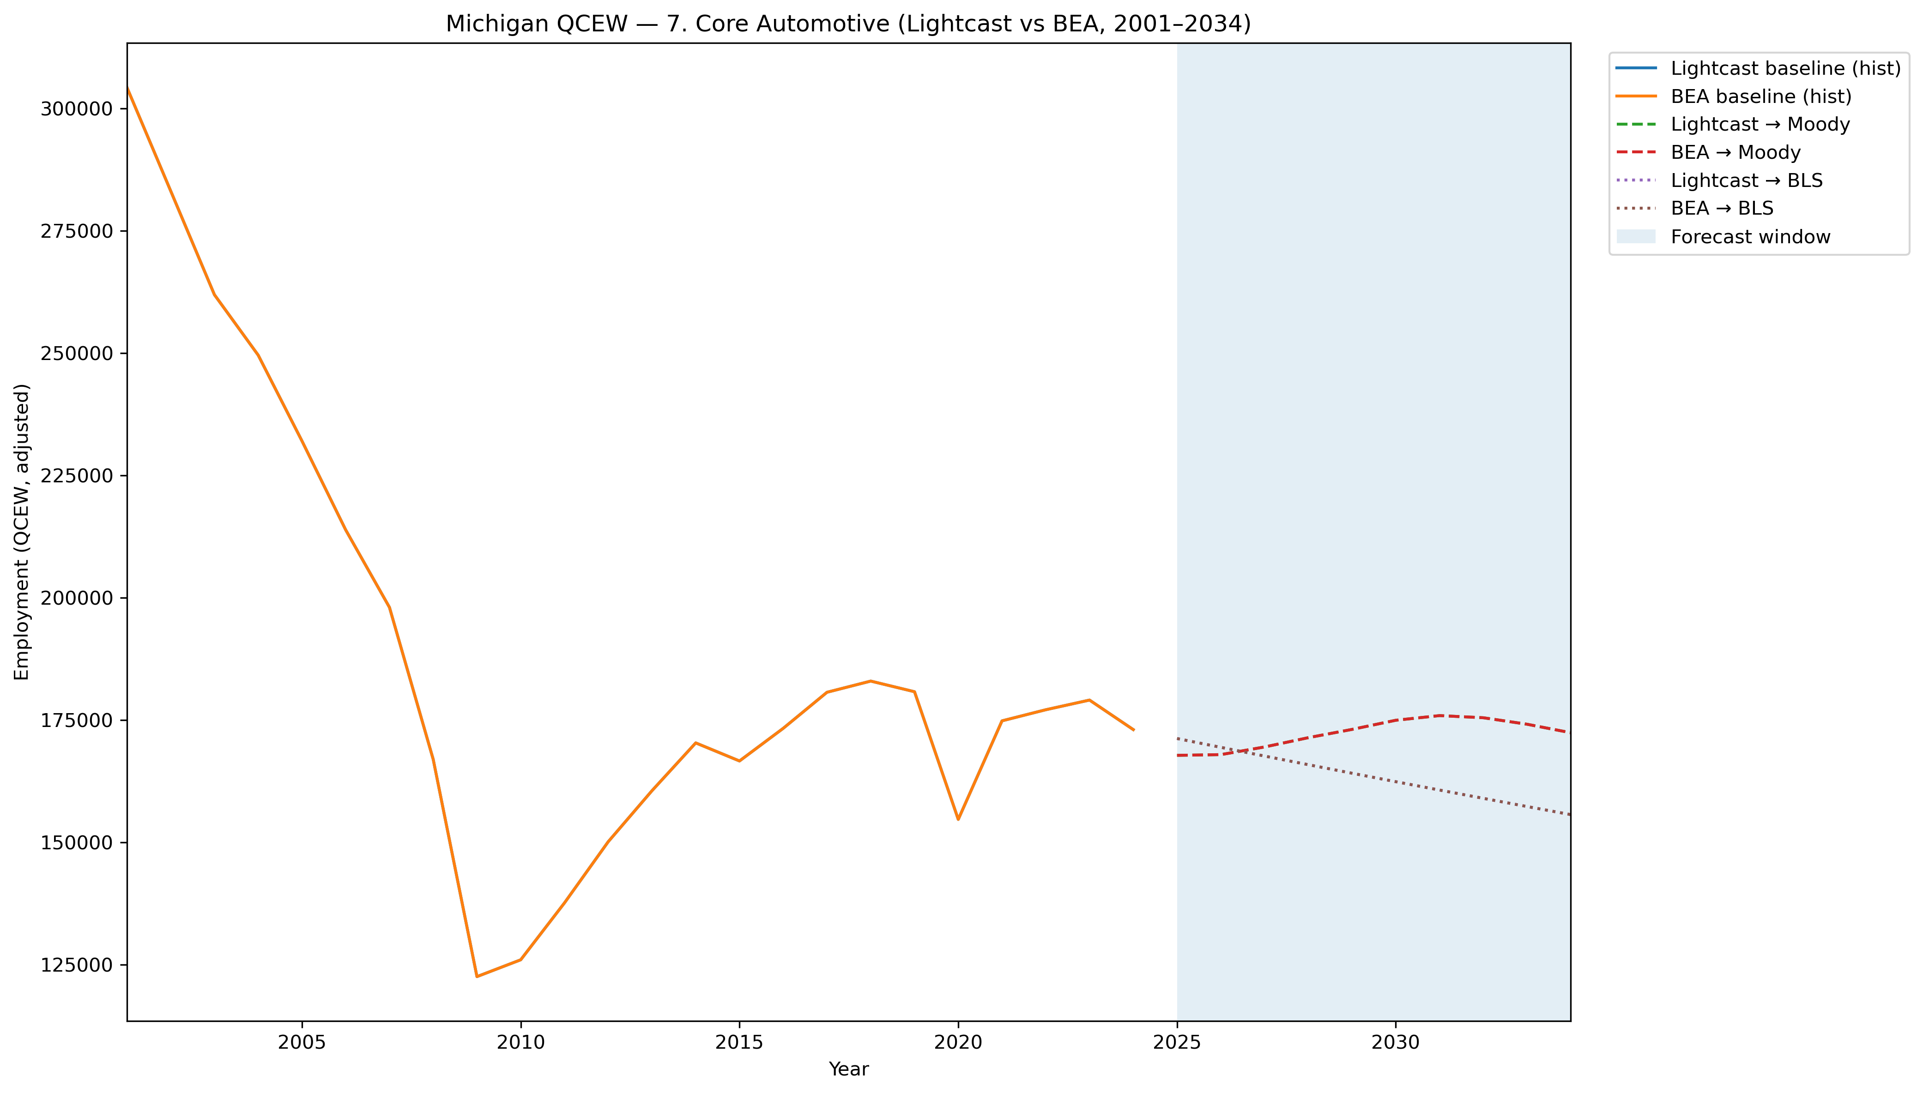
Mi Qcew Compare Segment 7 Lightcast Vs Bea 2001 2034
Source: EV Transition Forecasts

Slide 57
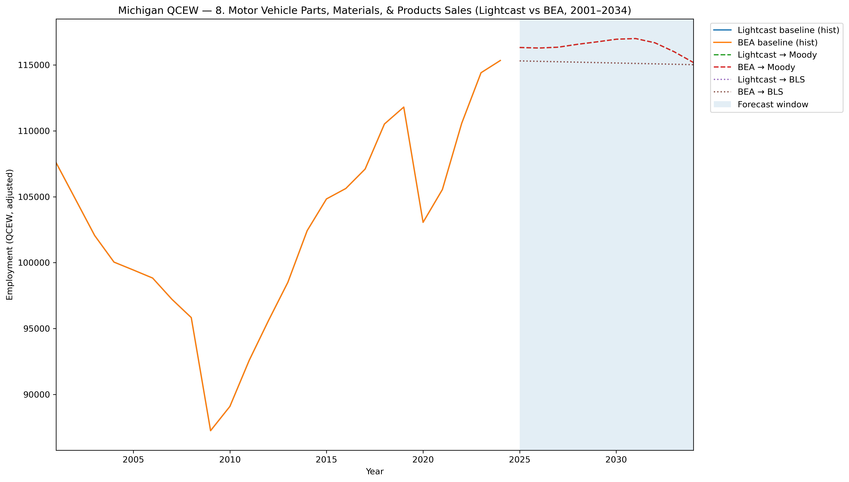
Mi Qcew Compare Segment 8 Lightcast Vs Bea 2001 2034
Source: EV Transition Forecasts

Slide 58
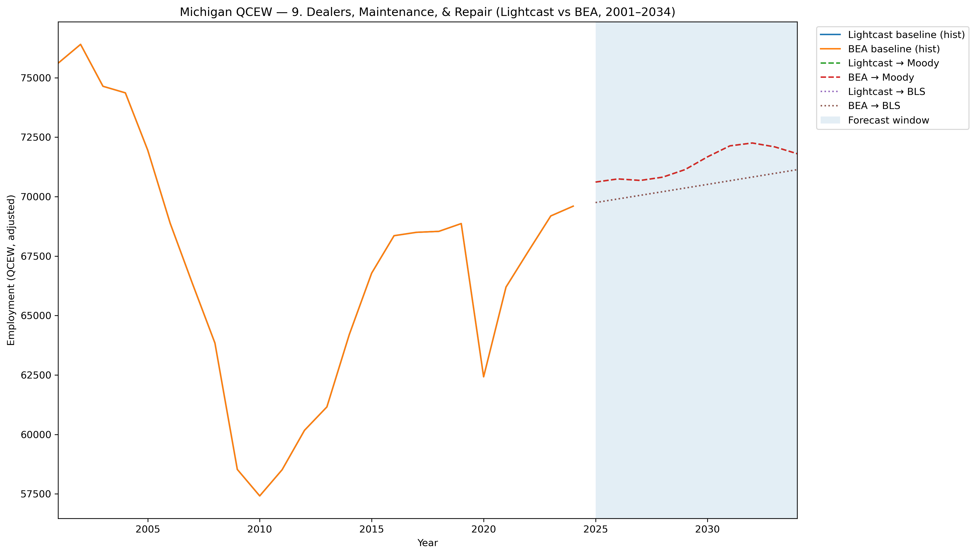
Mi Qcew Compare Segment 9 Lightcast Vs Bea 2001 2034
Source: EV Transition Forecasts

Slide 59
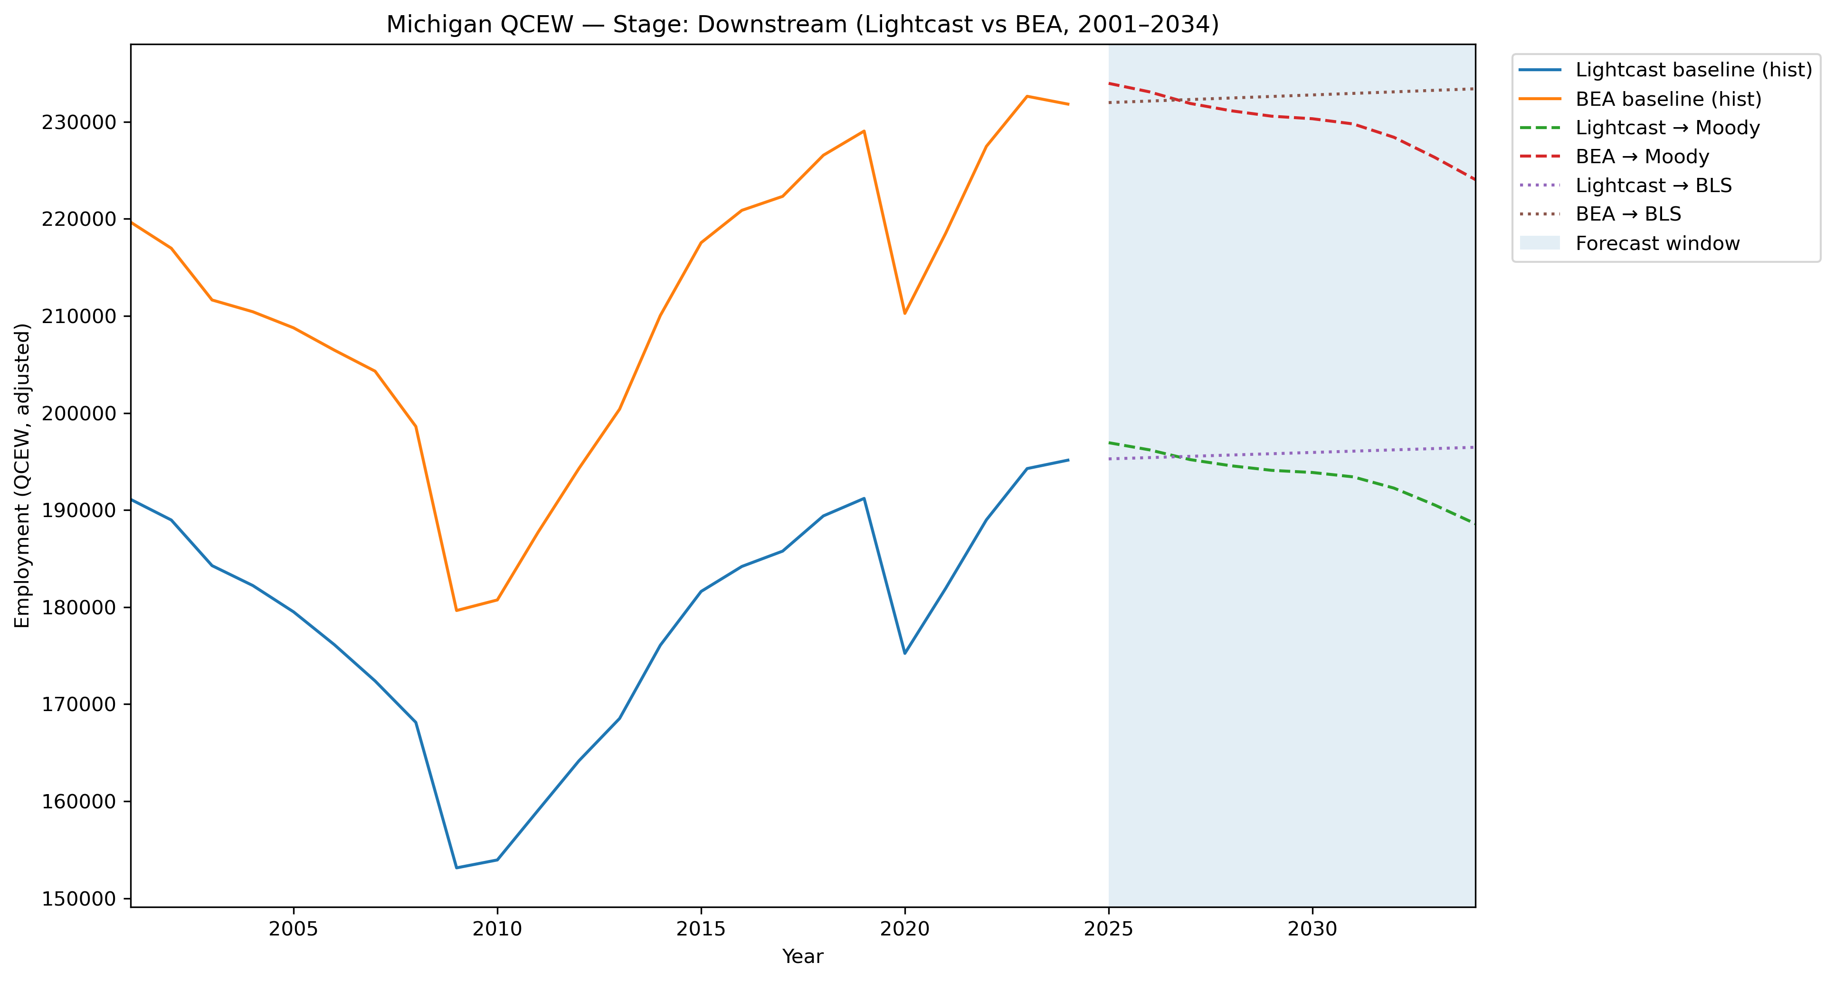
Mi Qcew Compare Stage Downstream Lightcast Vs Bea 2001 2034
Source: EV Transition Forecasts

Slide 60
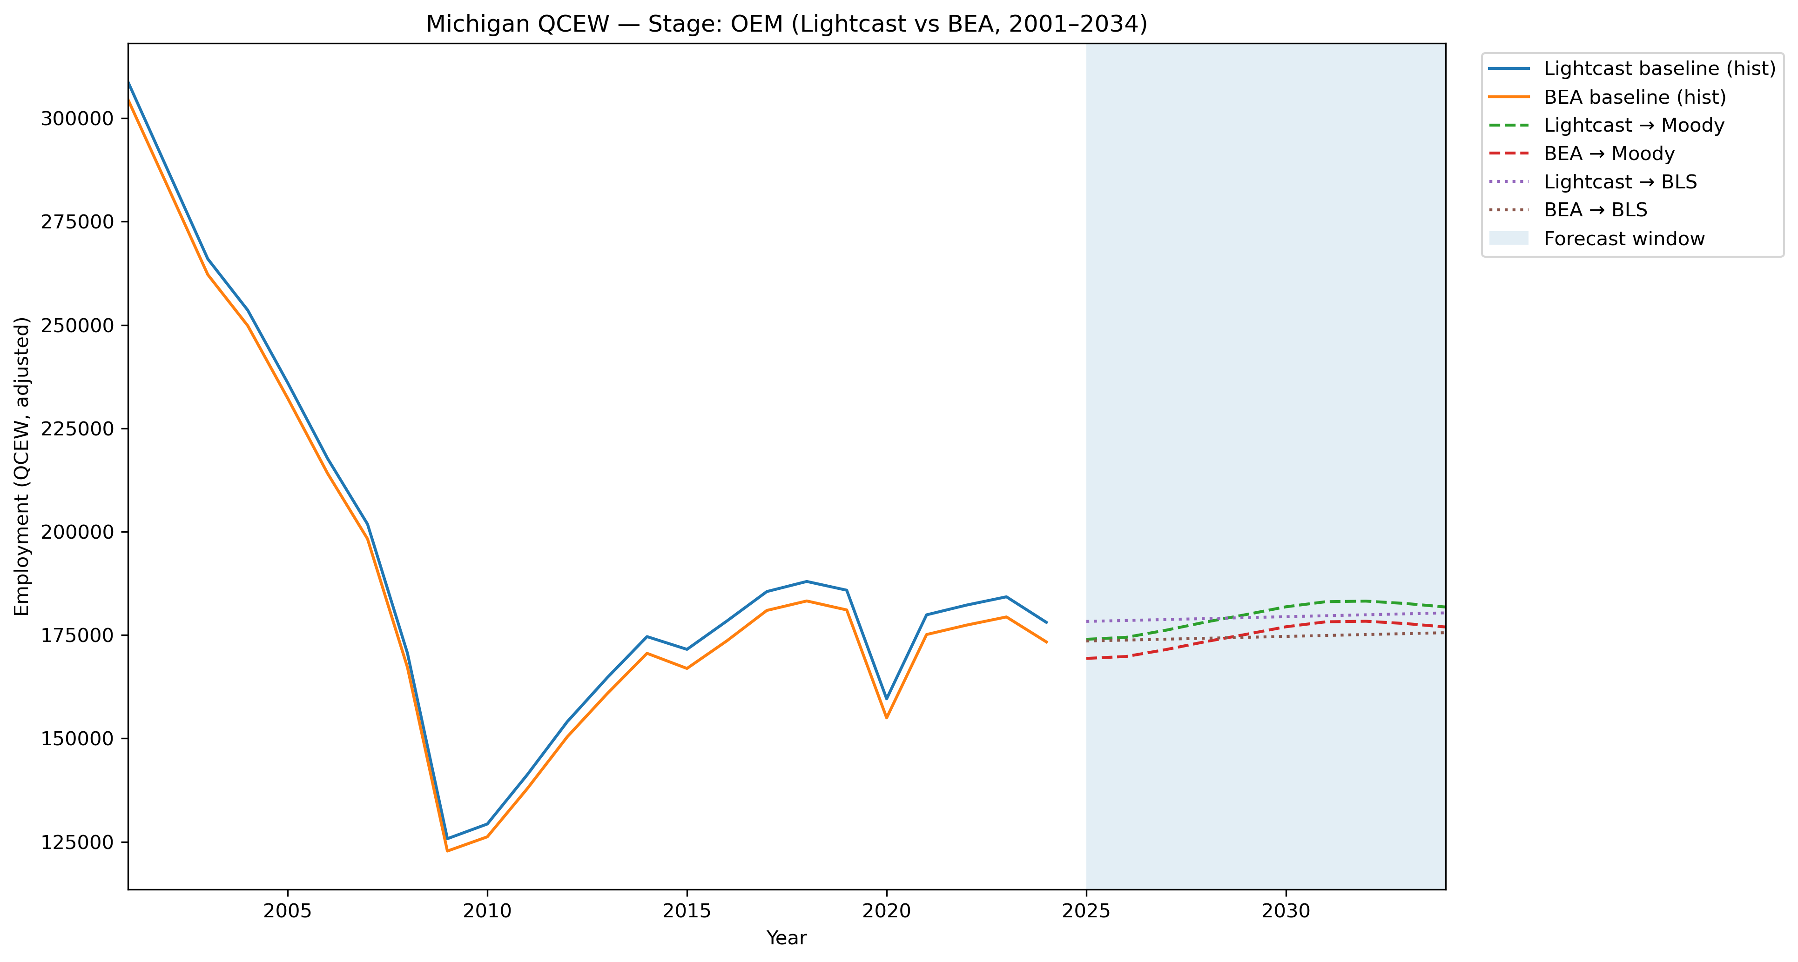
Mi Qcew Compare Stage Oem Lightcast Vs Bea 2001 2034
Source: EV Transition Forecasts

Slide 61
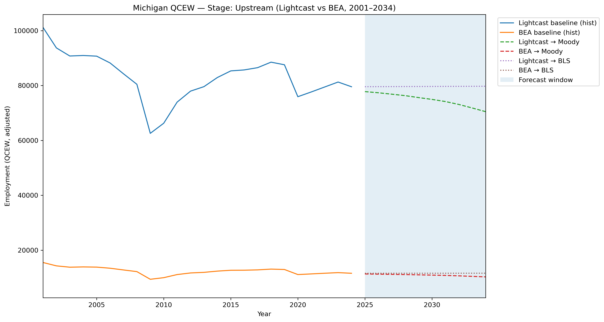
Mi Qcew Compare Stage Upstream Lightcast Vs Bea 2001 2034
Source: EV Transition Forecasts

Slide 62
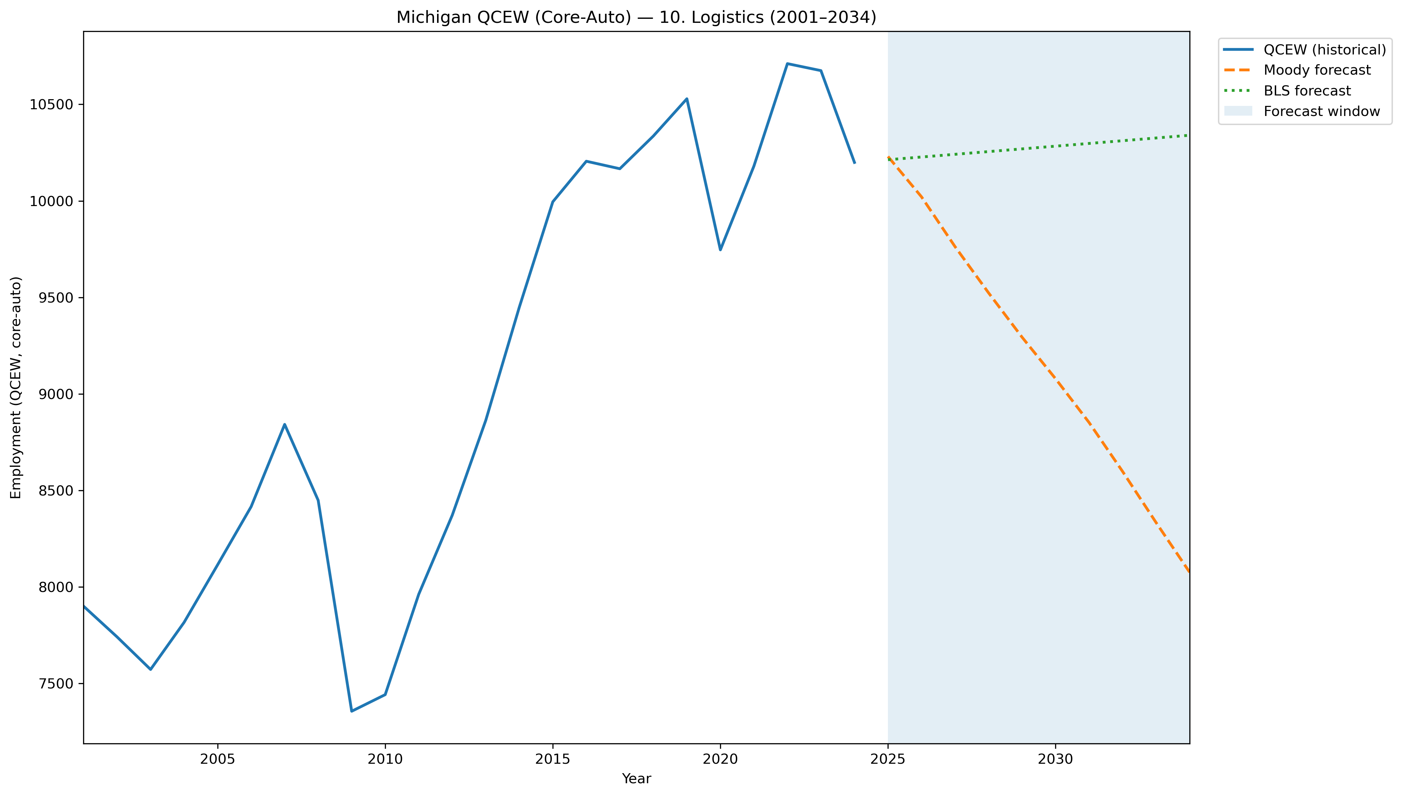
Mi Qcew Coreauto Segment 10 Compare 2001 2034
Source: EV Transition Forecasts

Slide 63
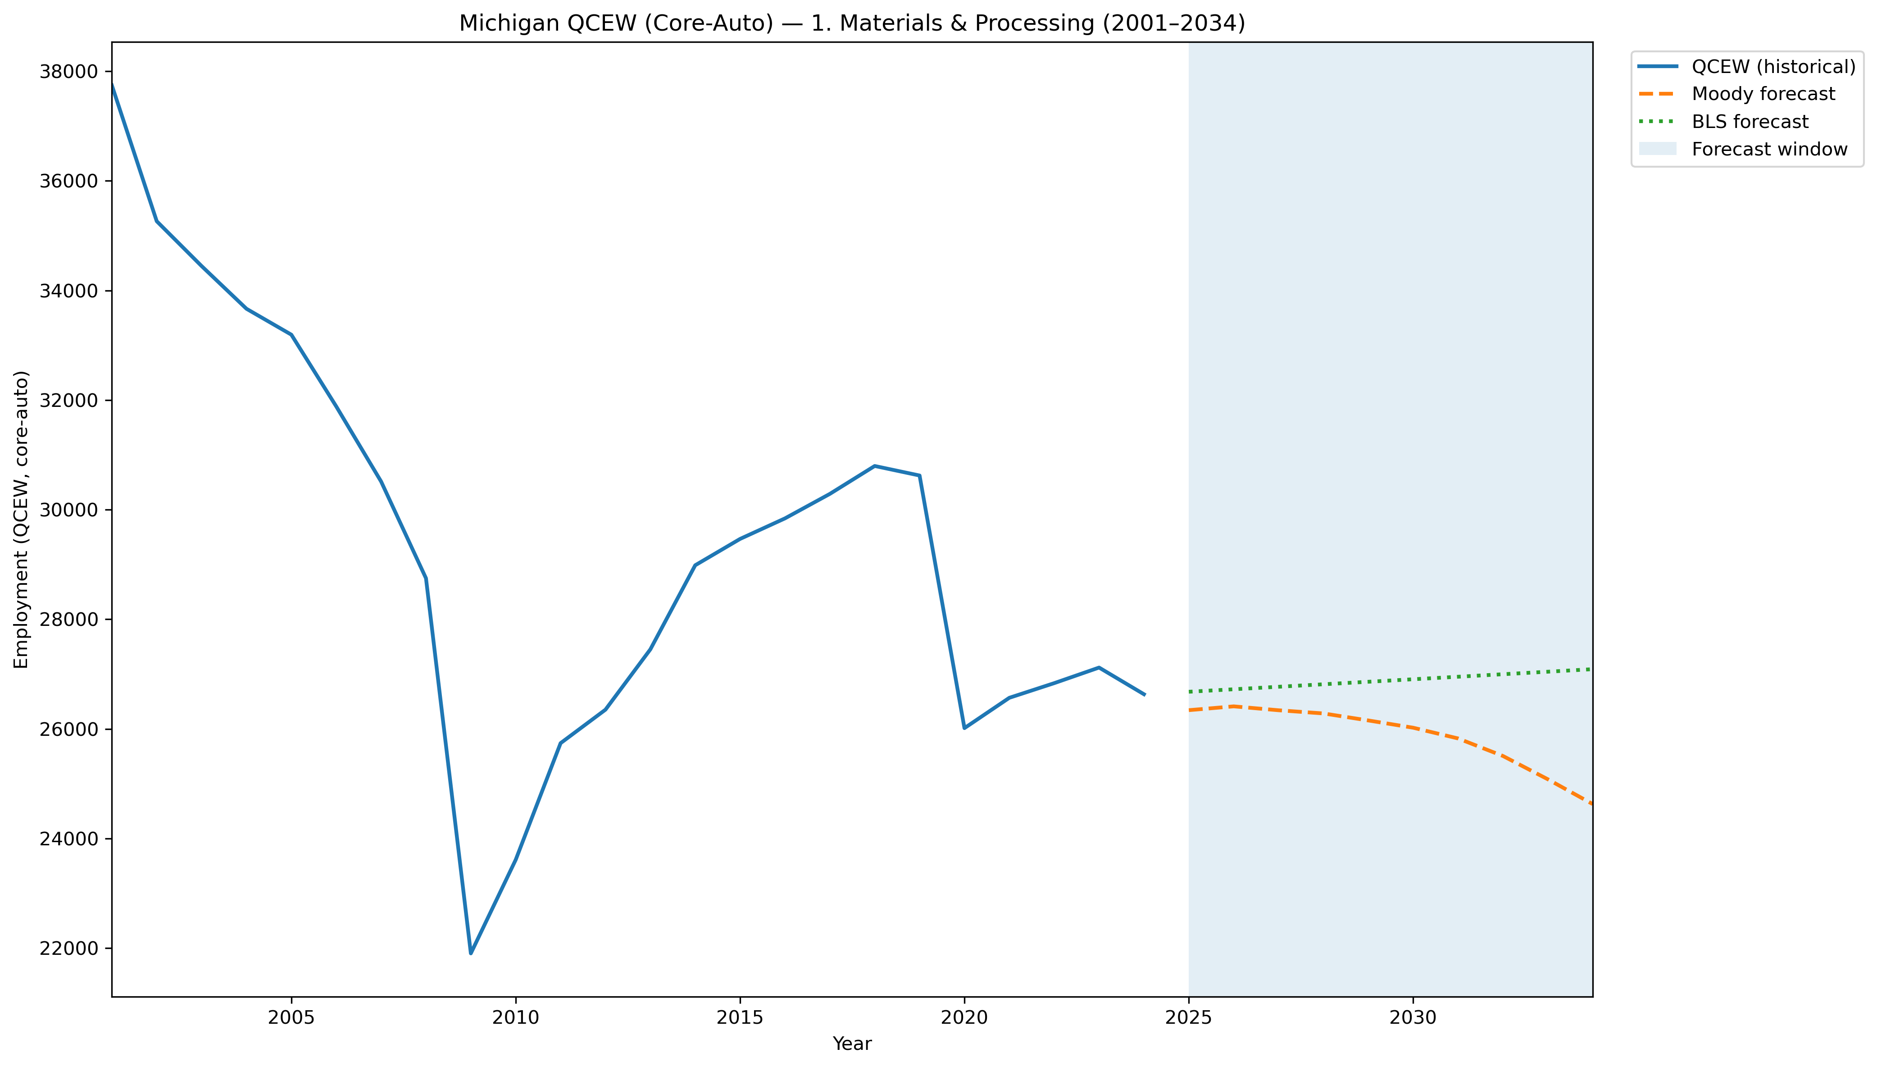
Mi Qcew Coreauto Segment 1 Compare 2001 2034
Source: EV Transition Forecasts

Slide 64
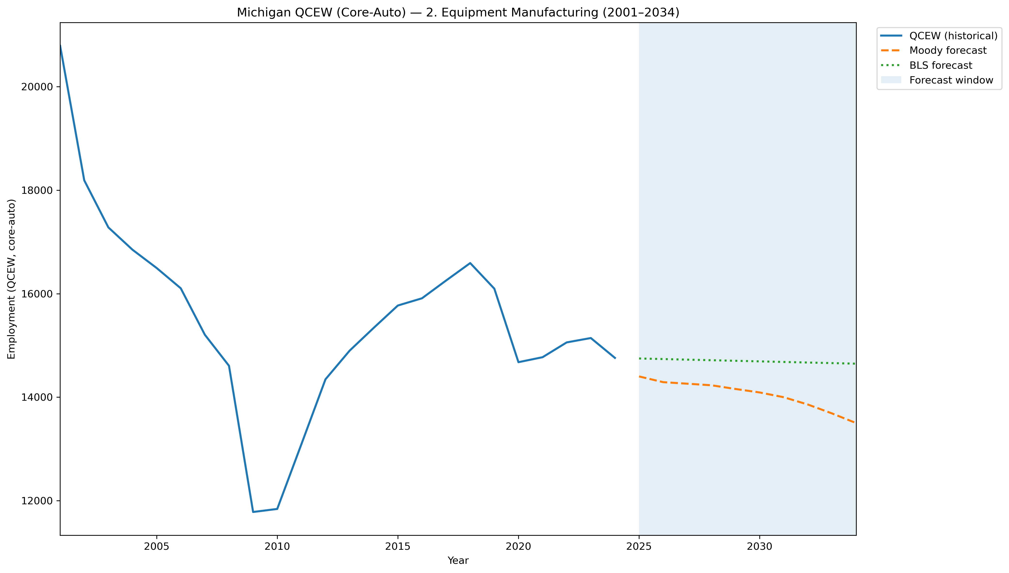
Mi Qcew Coreauto Segment 2 Compare 2001 2034
Source: EV Transition Forecasts

Slide 65
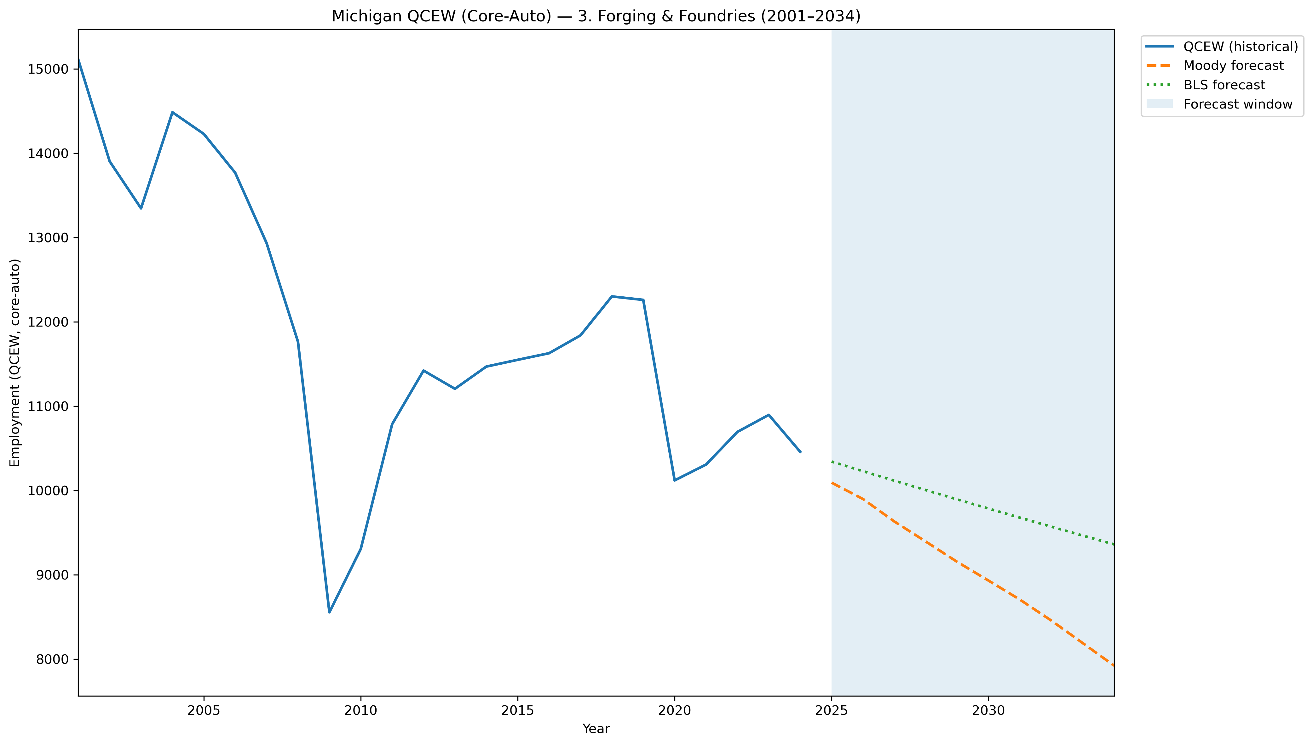
Mi Qcew Coreauto Segment 3 Compare 2001 2034
Source: EV Transition Forecasts

Slide 66
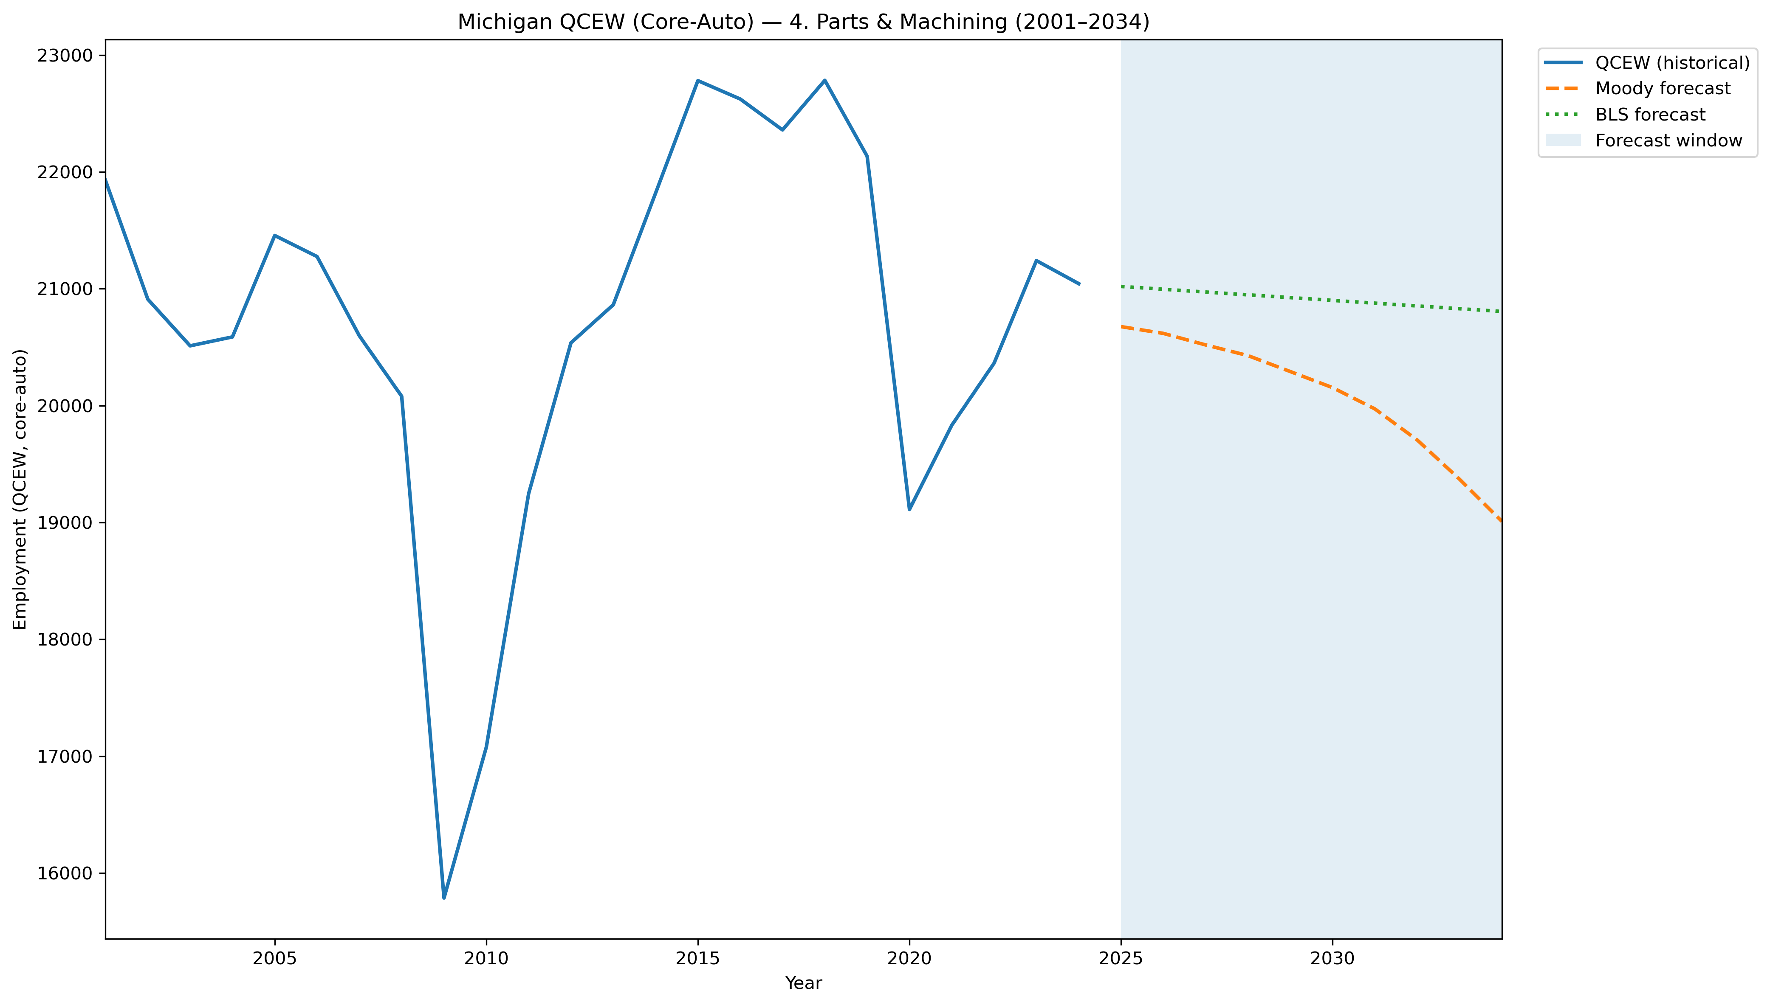
Mi Qcew Coreauto Segment 4 Compare 2001 2034
Source: EV Transition Forecasts

Slide 67
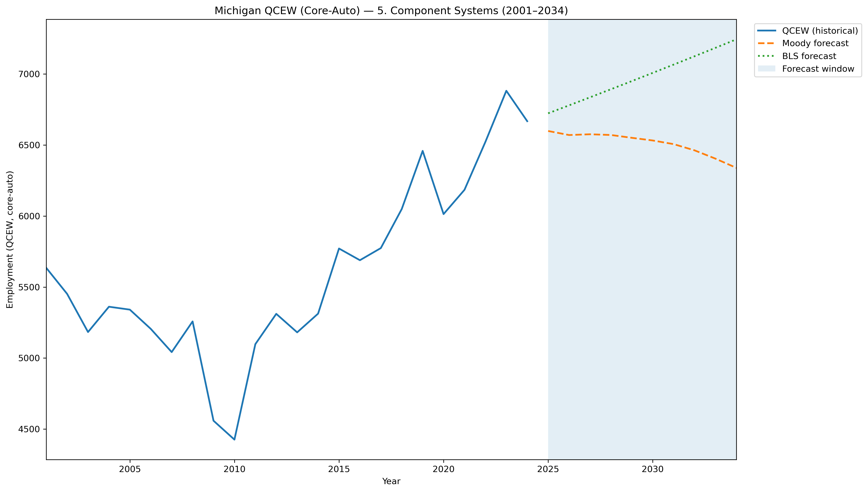
Mi Qcew Coreauto Segment 5 Compare 2001 2034
Source: EV Transition Forecasts

Slide 68
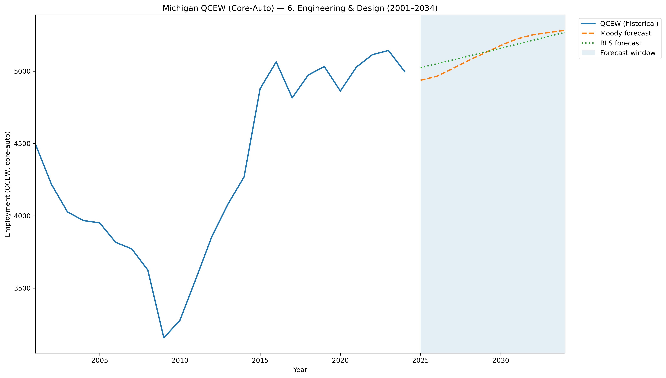
Mi Qcew Coreauto Segment 6 Compare 2001 2034
Source: EV Transition Forecasts

Slide 69
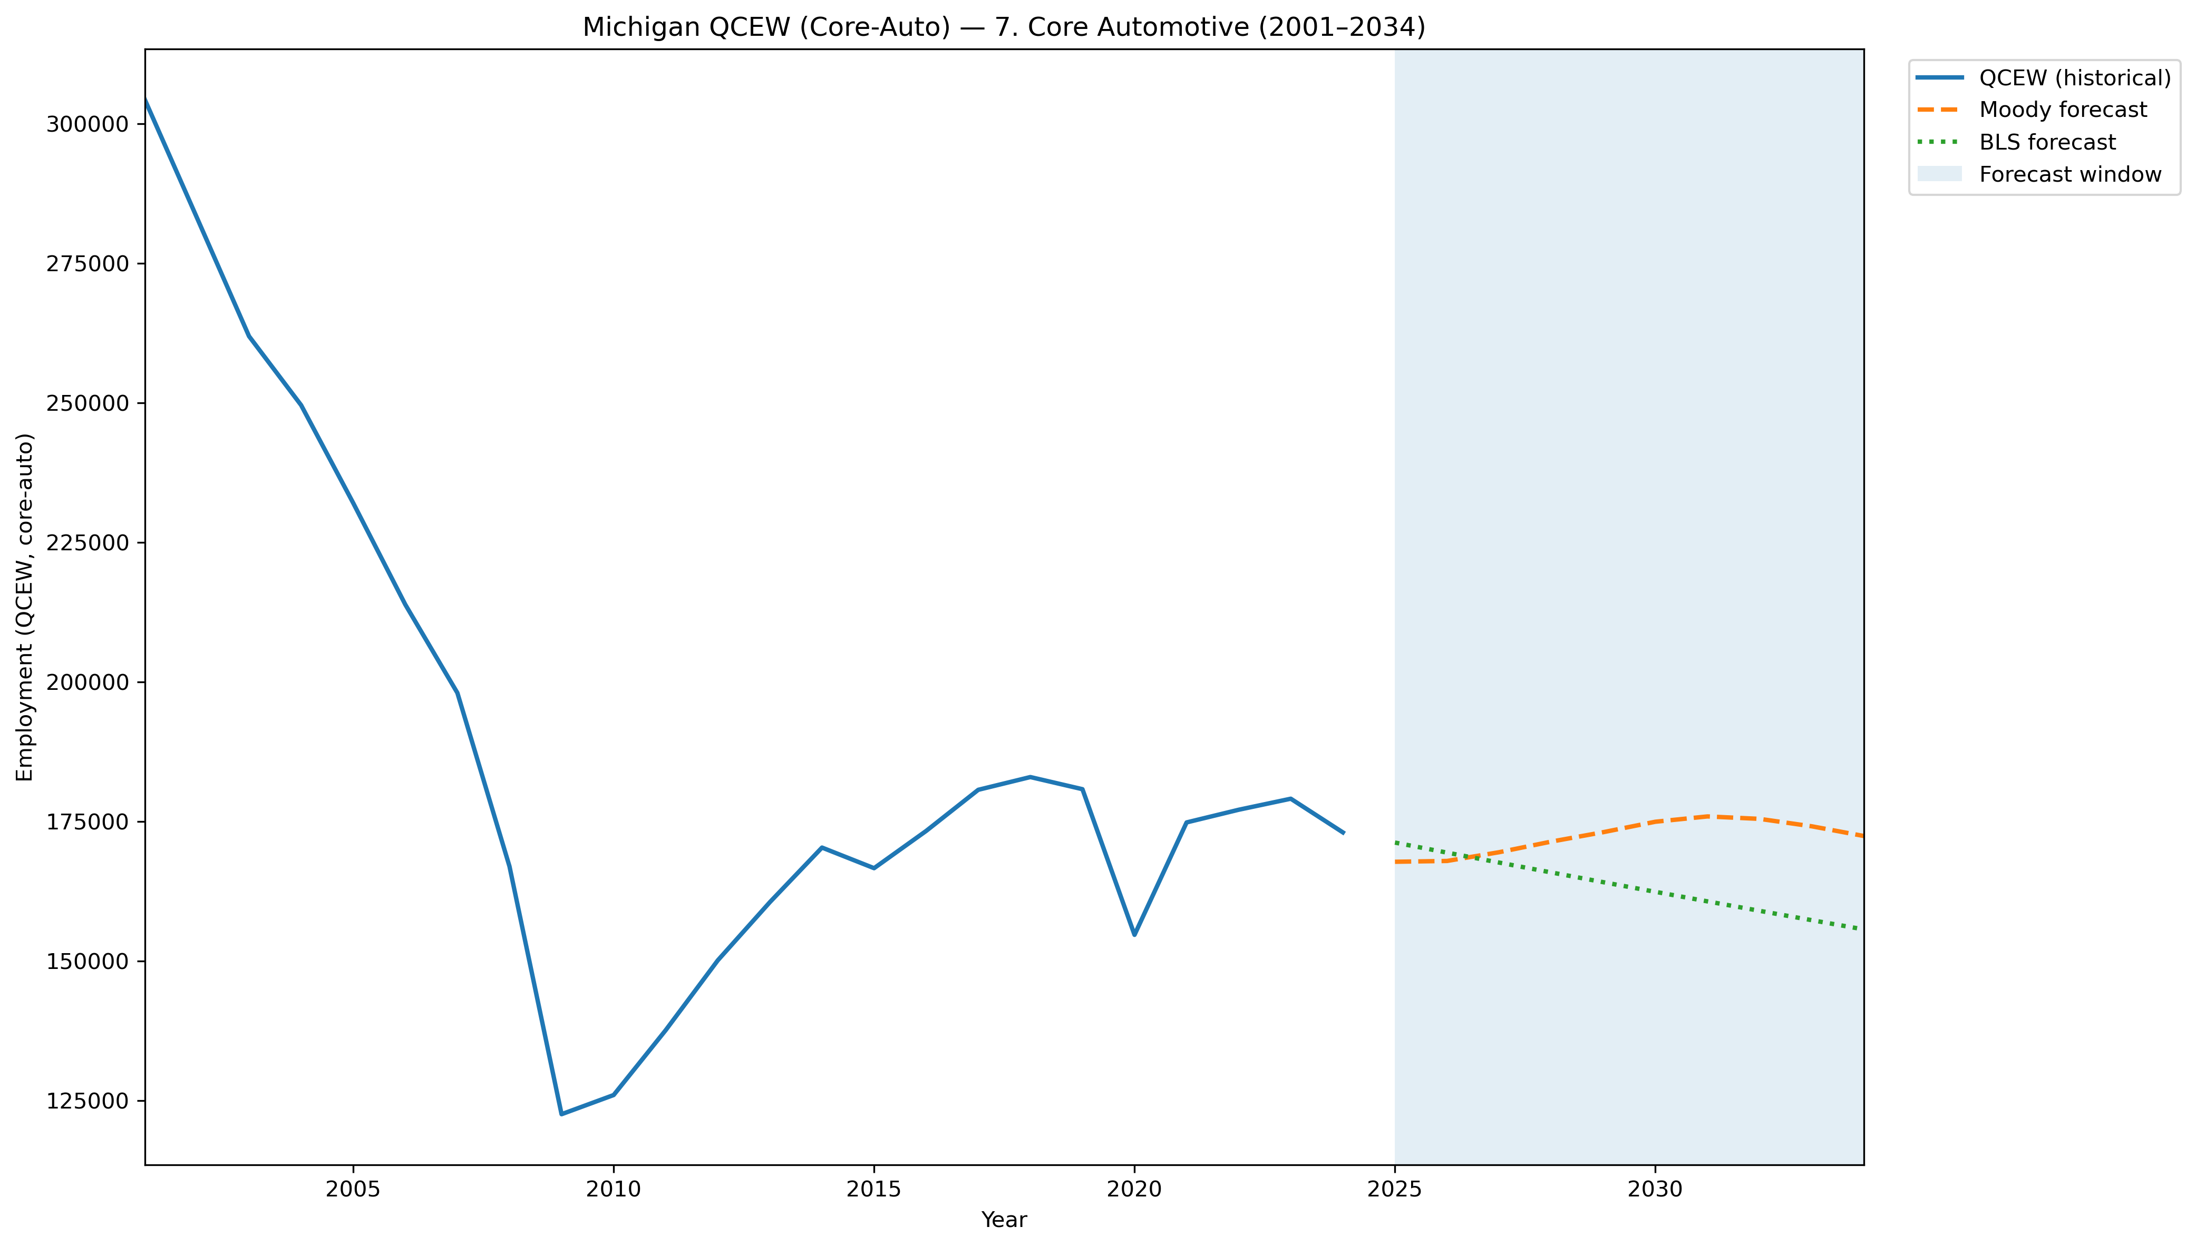
Mi Qcew Coreauto Segment 7 Compare 2001 2034
Source: EV Transition Forecasts

Slide 70
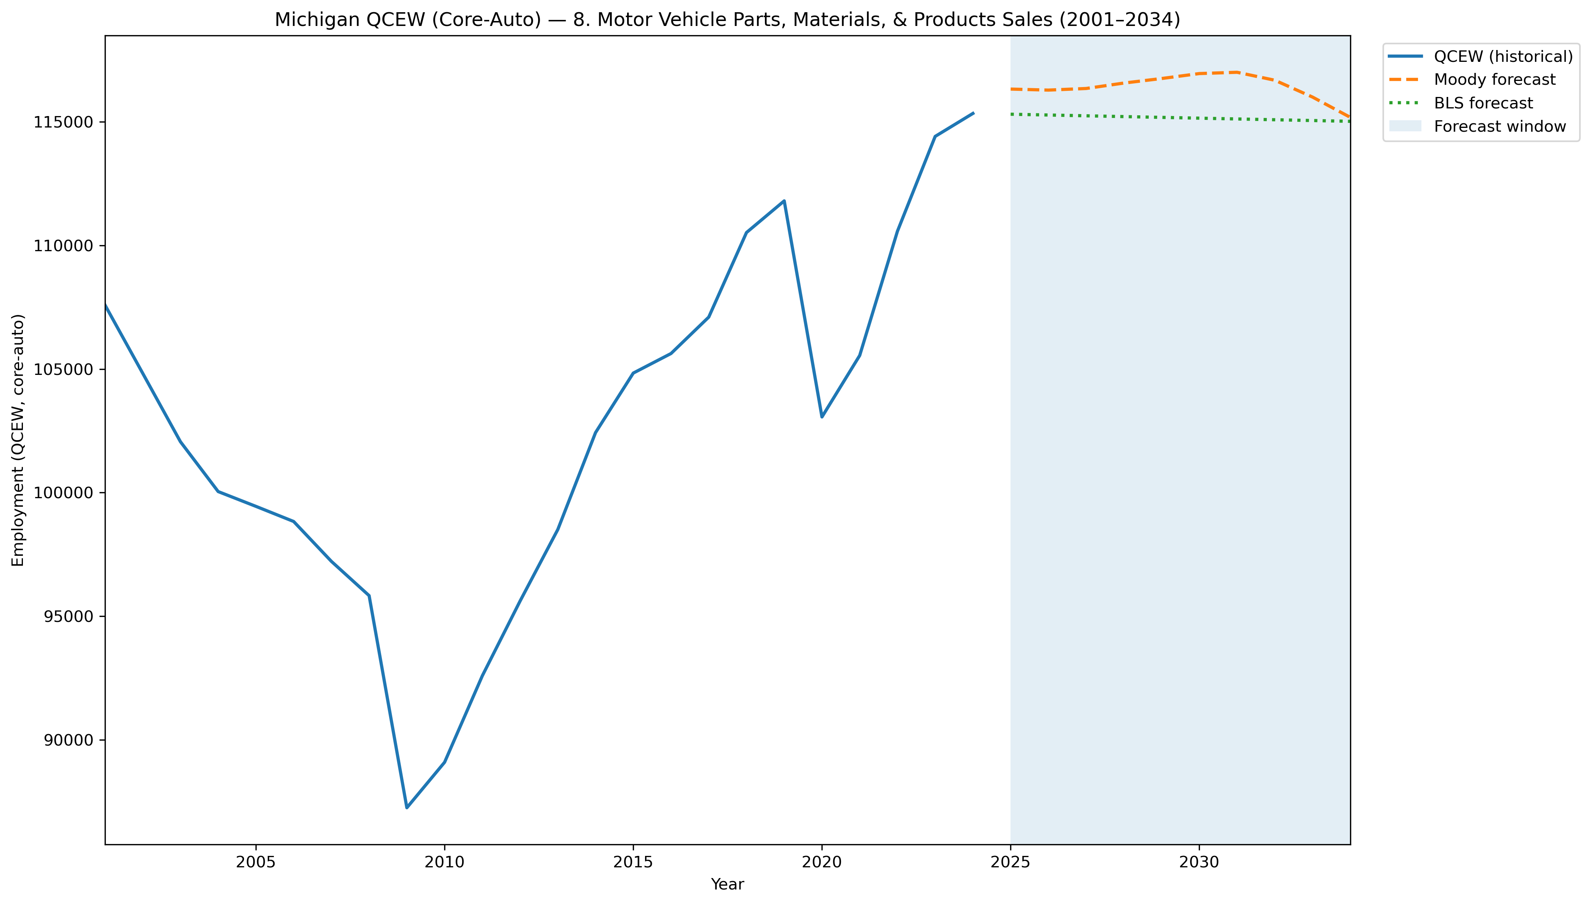
Mi Qcew Coreauto Segment 8 Compare 2001 2034
Source: EV Transition Forecasts

Slide 71
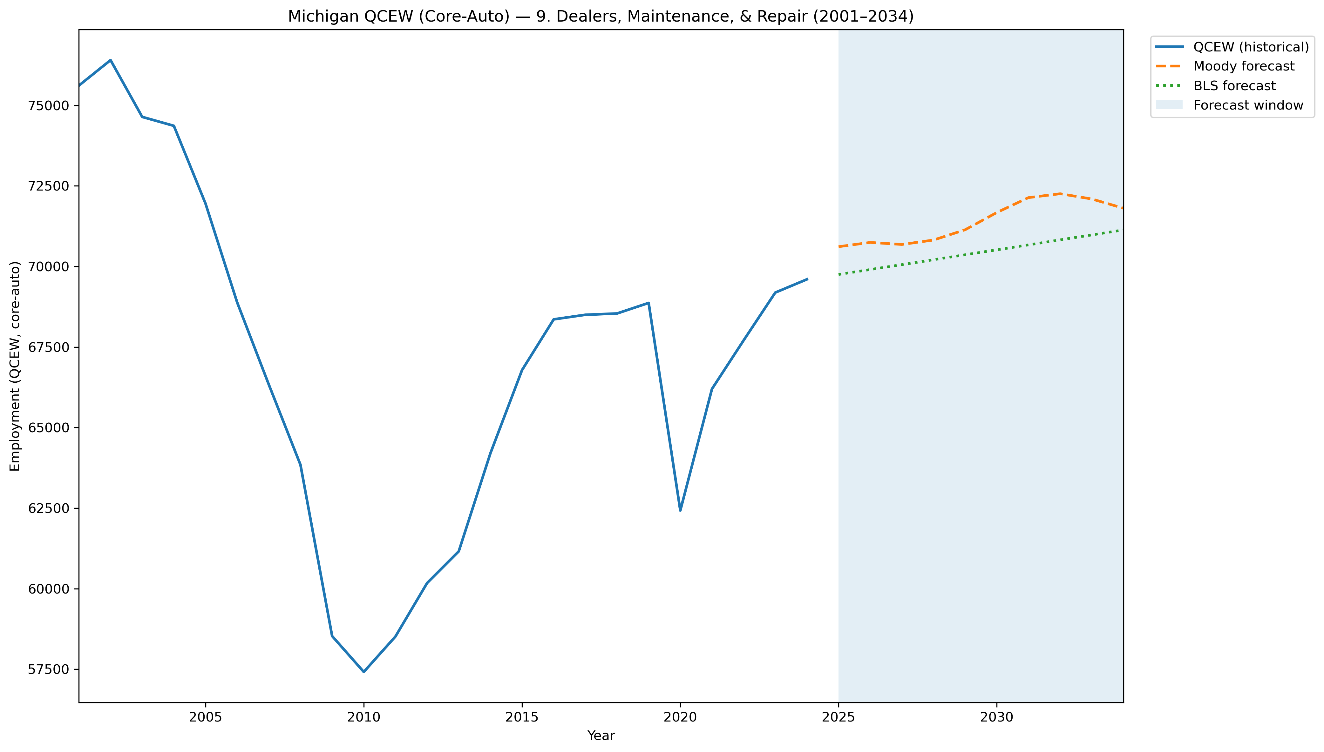
Mi Qcew Coreauto Segment 9 Compare 2001 2034
Source: EV Transition Forecasts

Slide 72
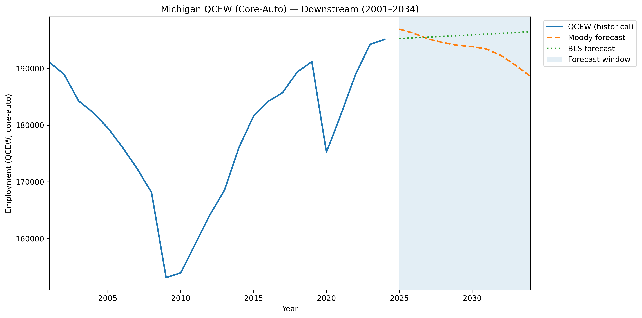
Mi Qcew Coreauto Stage Downstream Compare 2001 2034
Source: EV Transition Forecasts

Slide 73
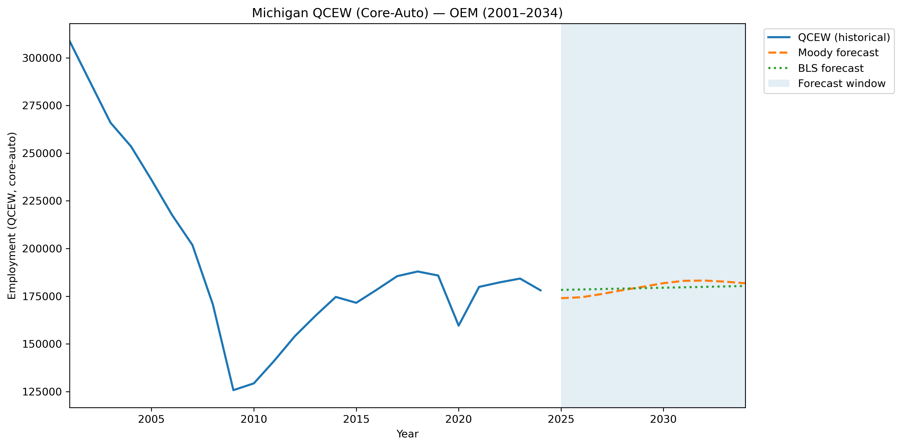
Mi Qcew Coreauto Stage Oem Compare 2001 2034
Source: EV Transition Forecasts

Slide 74
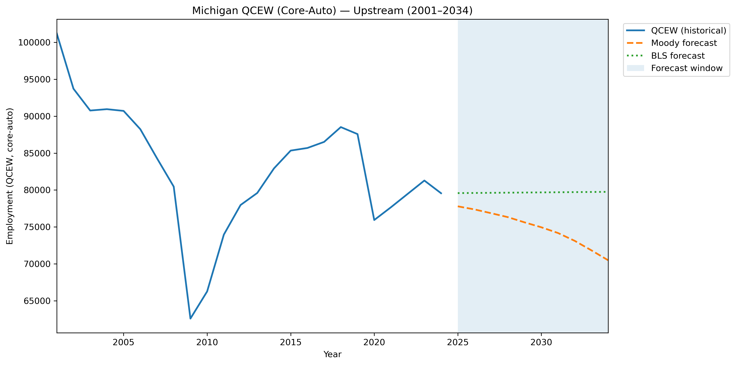
Mi Qcew Coreauto Stage Upstream Compare 2001 2034
Source: EV Transition Forecasts

Slide 75
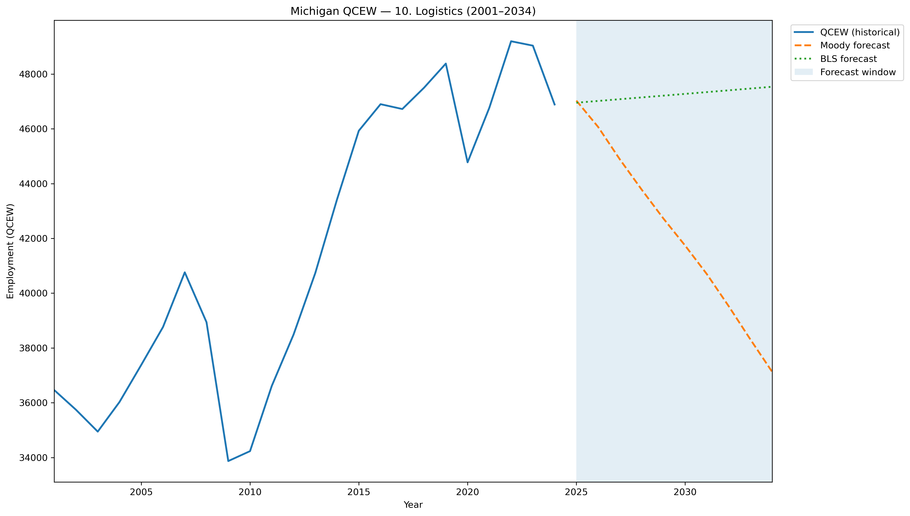
Mi Qcew Segment 10 Compare 2001 2034
Source: EV Transition Forecasts

Slide 76
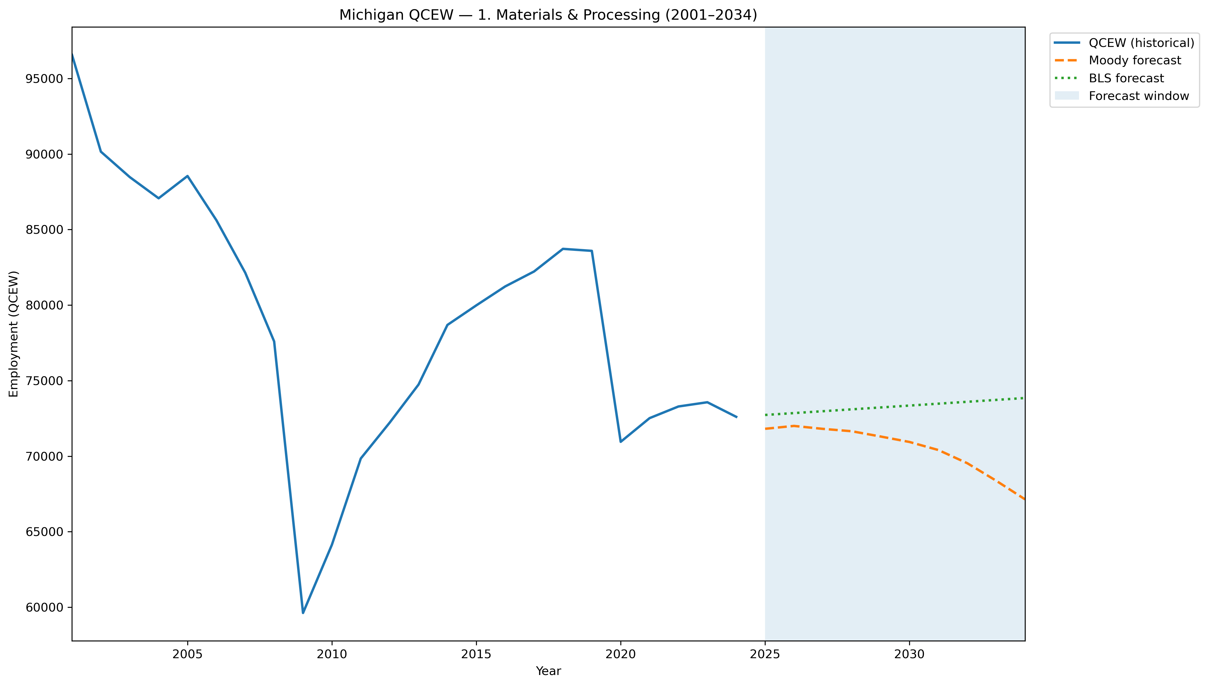
Mi Qcew Segment 1 Compare 2001 2034
Source: EV Transition Forecasts

Slide 77
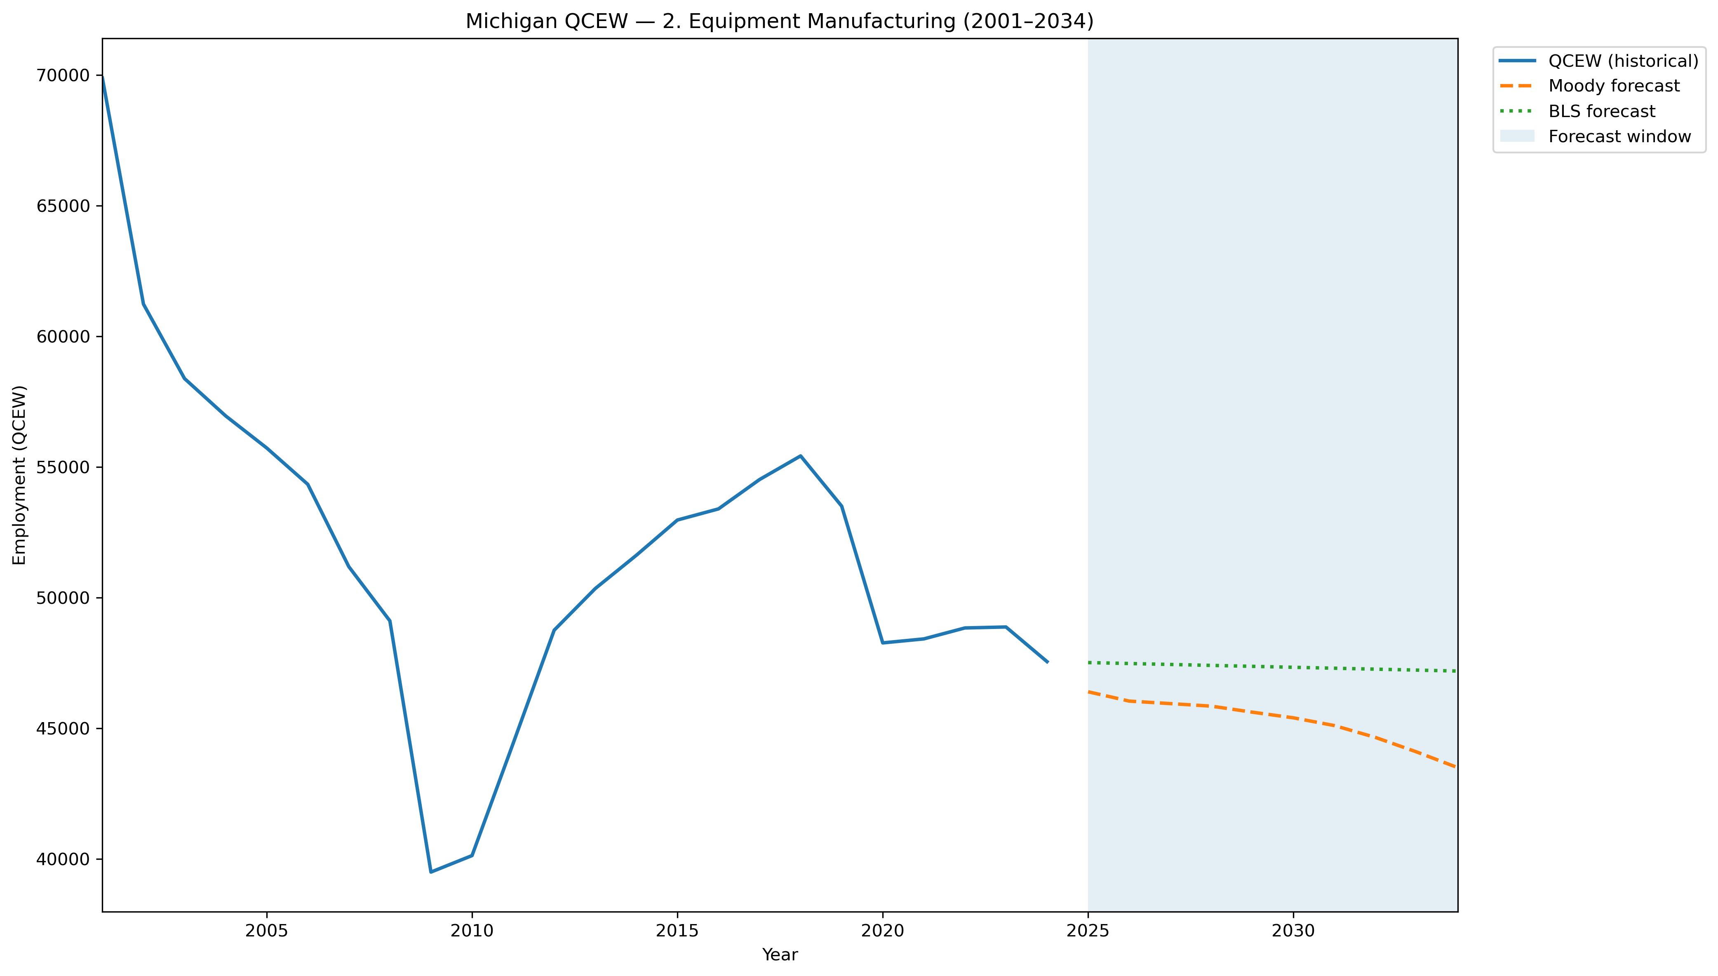
Mi Qcew Segment 2 Compare 2001 2034
Source: EV Transition Forecasts

Slide 78
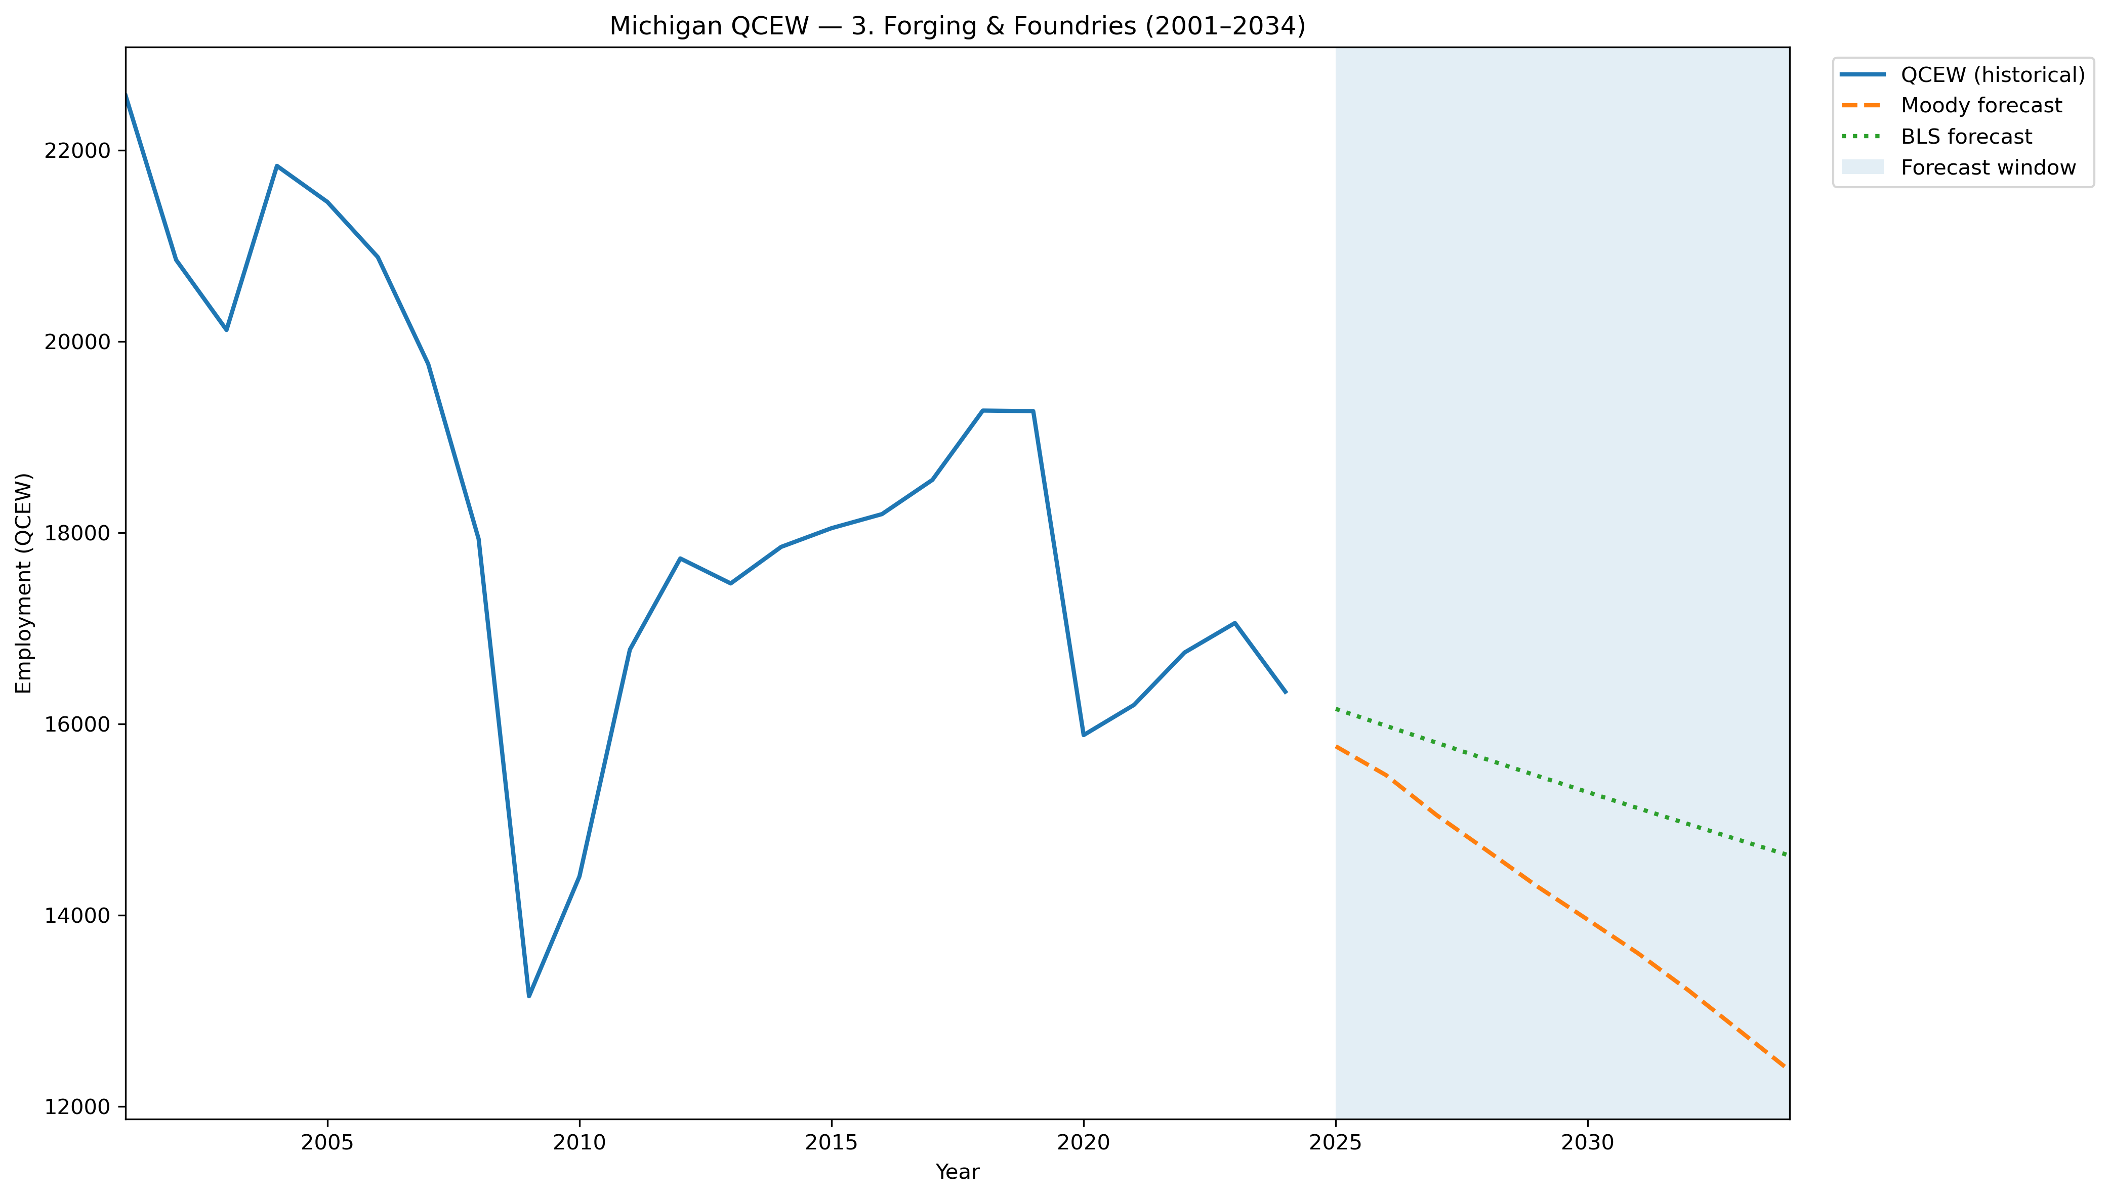
Mi Qcew Segment 3 Compare 2001 2034
Source: EV Transition Forecasts

Slide 79
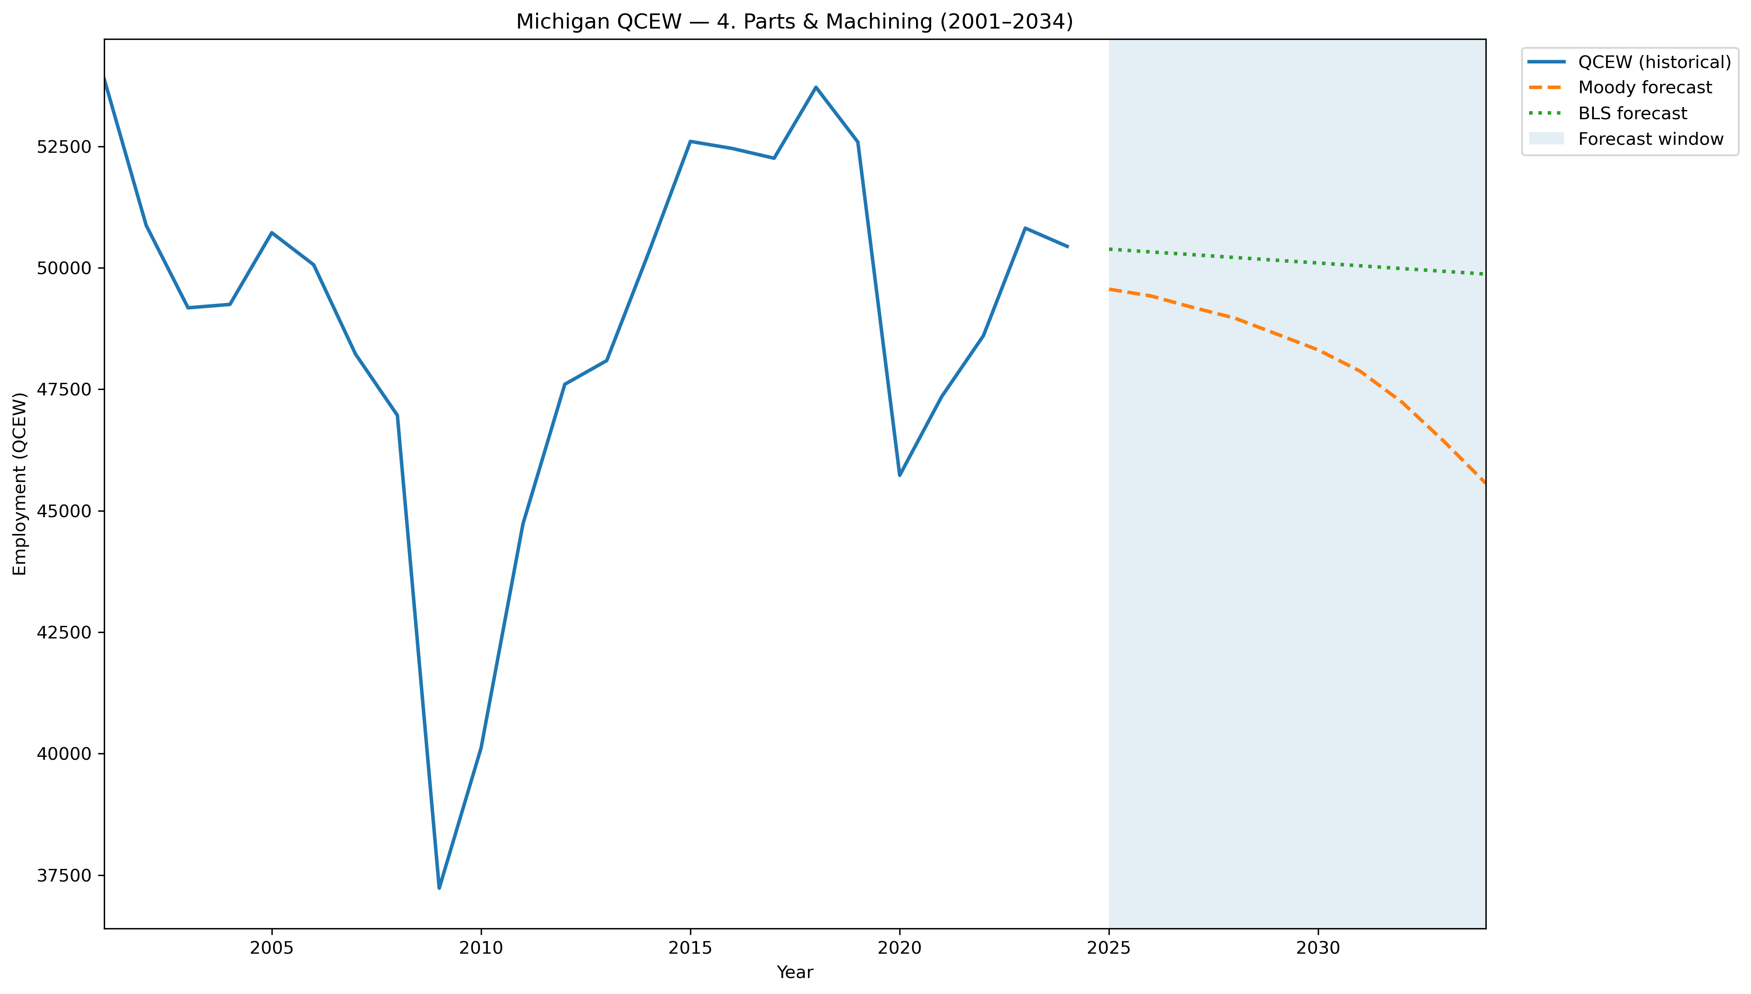
Mi Qcew Segment 4 Compare 2001 2034
Source: EV Transition Forecasts

Slide 80
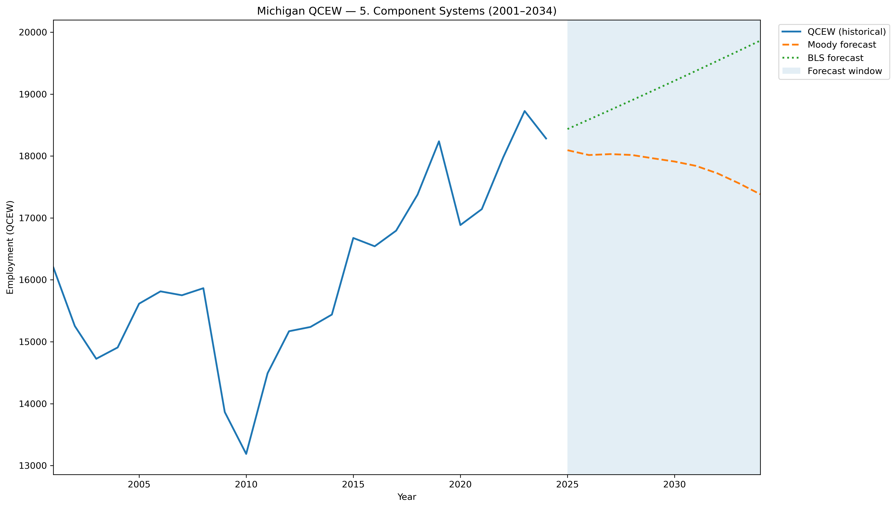
Mi Qcew Segment 5 Compare 2001 2034
Source: EV Transition Forecasts

Slide 81

Mi Qcew Segment 6 Compare 2001 2034
Source: EV Transition Forecasts

Slide 82

Mi Qcew Segment 7 Compare 2001 2034
Source: EV Transition Forecasts

Slide 83

Mi Qcew Segment 8 Compare 2001 2034
Source: EV Transition Forecasts

Slide 84

Mi Qcew Segment 9 Compare 2001 2034
Source: EV Transition Forecasts

Slide 85

Mi Qcew Segment Employment Trends
Source: EV Transition Forecasts

Slide 86

Mi Qcew Segments 2001 2034 With Forecast
Source: EV Transition Forecasts

Slide 87

Mi Qcew Stage Downstream Compare 2001 2034
Source: EV Transition Forecasts

Slide 88

Mi Qcew Stage Employment Trends
Source: EV Transition Forecasts

Slide 89

Mi Qcew Stage Oem Compare 2001 2034
Source: EV Transition Forecasts

Slide 90

Mi Qcew Stage Upstream Compare 2001 2034
Source: EV Transition Forecasts

Slide 91

Mi Qcew Stages 2001 2034 With Forecast
Source: EV Transition Forecasts

Slide 92

Moodys Mi Segment Employment 1970 2055
Source: EV Transition Forecasts

Slide 93

Moodys Mi Segment Employment 1990 2030
Source: EV Transition Forecasts

Slide 94

Moodys Mi Segment Gdp 1970 2055
Source: EV Transition Forecasts

Slide 95

Moodys Mi Segment Gdp 1990 2030
Source: EV Transition Forecasts

Slide 96

Moodys Mi Stage Employment 1970 2055
Source: EV Transition Forecasts

Slide 97

Moodys Mi Stage Employment 1990 2030
Source: EV Transition Forecasts

Slide 98

Moodys Mi Stage Gdp 1970 2055
Source: EV Transition Forecasts

Slide 99

Moodys Mi Stage Gdp 1990 2030
Source: EV Transition Forecasts

Slide 100

Moodys Us Segment Employment 1970 2055
Source: EV Transition Forecasts

Slide 101

Moodys Us Segment Employment 1990 2030
Source: EV Transition Forecasts

Slide 102

Moodys Us Segment Gdp 1970 2055
Source: EV Transition Forecasts

Slide 103

Moodys Us Segment Gdp 1990 2030
Source: EV Transition Forecasts

Slide 104

Moodys Us Stage Employment 1970 2055
Source: EV Transition Forecasts

Slide 105

Moodys Us Stage Employment 1990 2030
Source: EV Transition Forecasts

Slide 106

Moodys Us Stage Gdp 1970 2055
Source: EV Transition Forecasts

Slide 107

Moodys Us Stage Gdp 1990 2030
Source: EV Transition Forecasts

Slide 108

Occupation Methodology Comparison 2030
Source: EV Transition Forecasts

Slide 109
Occupation Segment Employment 2030
Source: EV Transition Forecasts

Slide 110

Occupation Top15 2030
Source: EV Transition Forecasts

Slide 111

Occupation Top5 Timeseries 2024 2034
Source: EV Transition Forecasts

Slide 112

Segment Employment Pct Change 2024 2030
Source: EV Transition Forecasts

Slide 113

Segment Gdpgpo Pct Change 2024 2030
Source: EV Transition Forecasts

Slide 114

Segment Wages Pct Change 2024 2030
Source: EV Transition Forecasts

Slide 115

Stage Employment Pct Change 2024 2030
Source: EV Transition Forecasts

Slide 116

Stage Gdpgpo Pct Change 2024 2030
Source: EV Transition Forecasts

Slide 117

Stage Wages Pct Change 2024 2030
Source: EV Transition Forecasts

